Slide 1
Advancing InfoSec Towards an Open, Shareable, Contributor-Friendly model of speeding InfoSec learning
John Lambert, @JohnLaTwC
Microsoft Threat Intelligence Center

Slide 2


Conventional Wisdom in Defense
Traditional Defenders
Defend a list of assets
Manage incidents
Minimize risks by keeping incidents secret
View pentest results as a report card
Think about stopping attacks
 | Modern Defenders
 | Defend a graph of assets
 | Manage adversaries
 | Maximize learning by sharing incidents with trusted outside peers
 | View pentest results as an input
 | They think about increasing attacker requirements

Slide 3
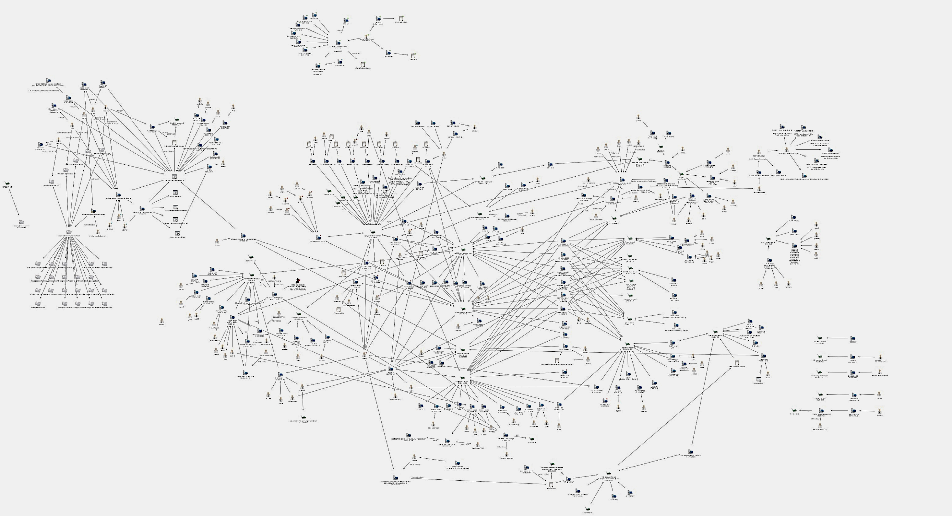
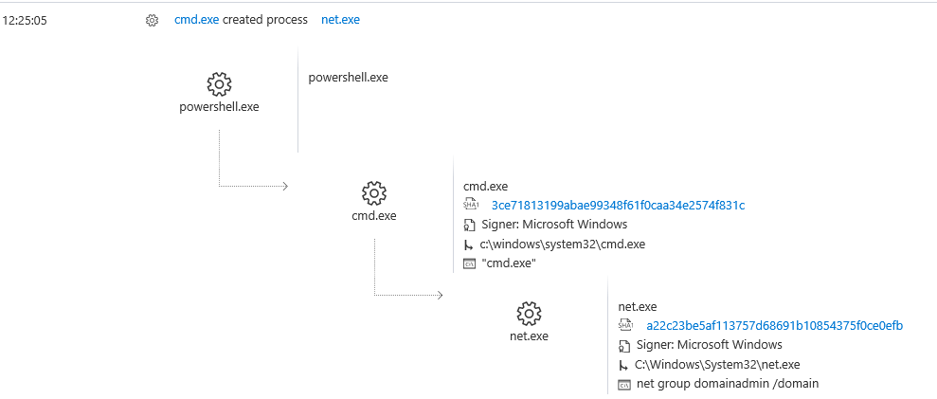
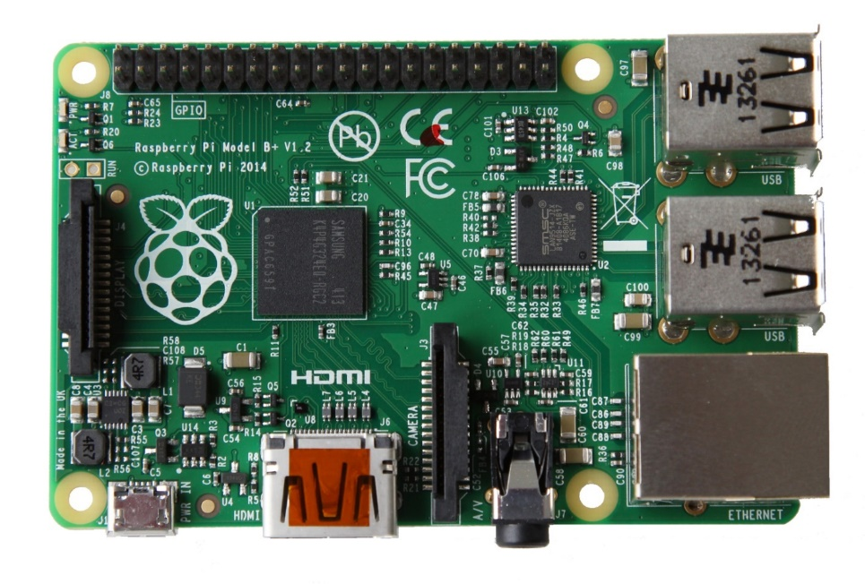
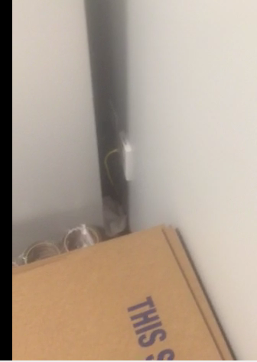
Insights

Slide 4
Insights
Reveal Cards
People that know each other’s strengths team better in a crisis
Sharing not shaming
Show up with tools and techniques to share
No scoring or ranking
Learning, teaching, collaboration
Strive for new findings and techniques

Slide 5
How do we increase the rate of learning in InfoSec?

Slide 6
If you want to go fast, go alone If you want to go far, go together African Proverb

Slide 7
Advancing InfoSec

Slide 8
Accelerating Learning in InfoSec
Promoting Community
Executable Know-how
Organized Knowledge
Repeatable Analysis

Slide 9
Promoting Community

Slide 10
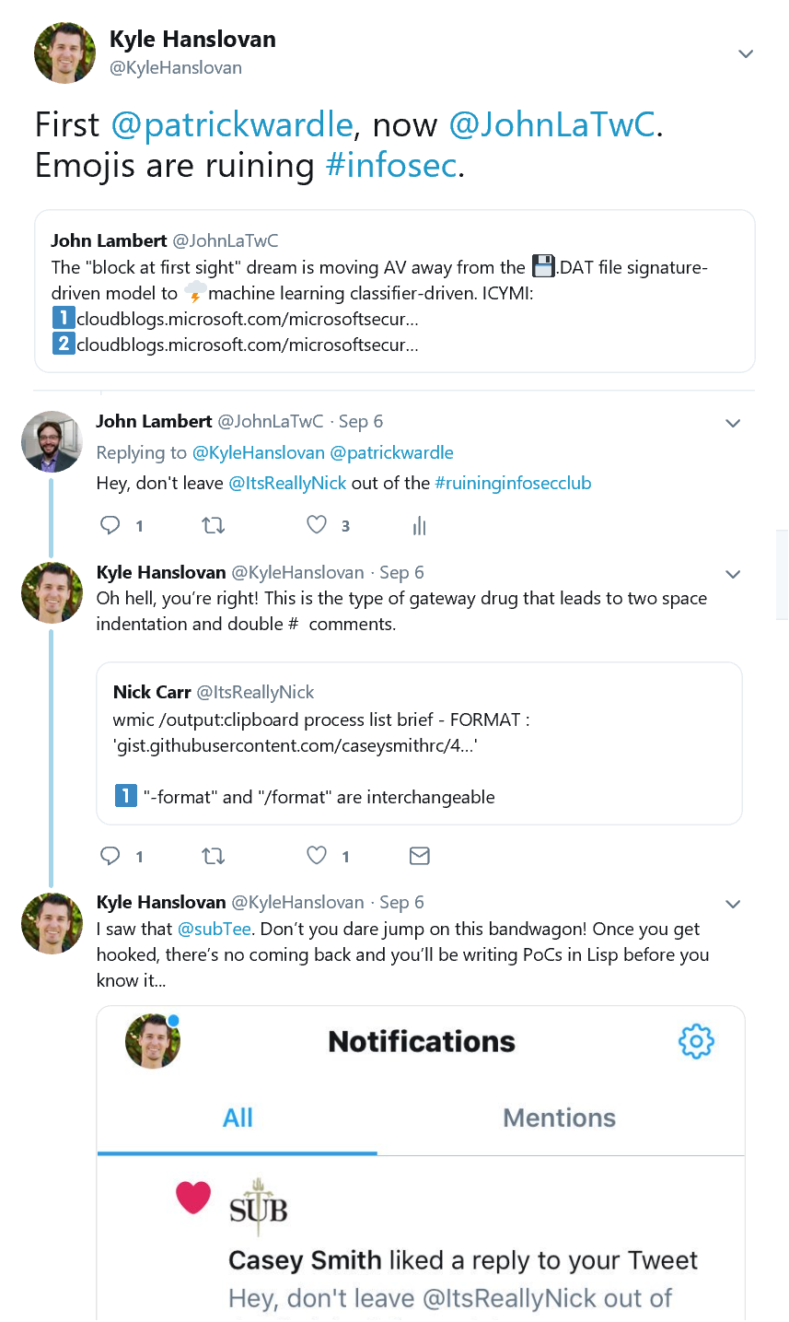
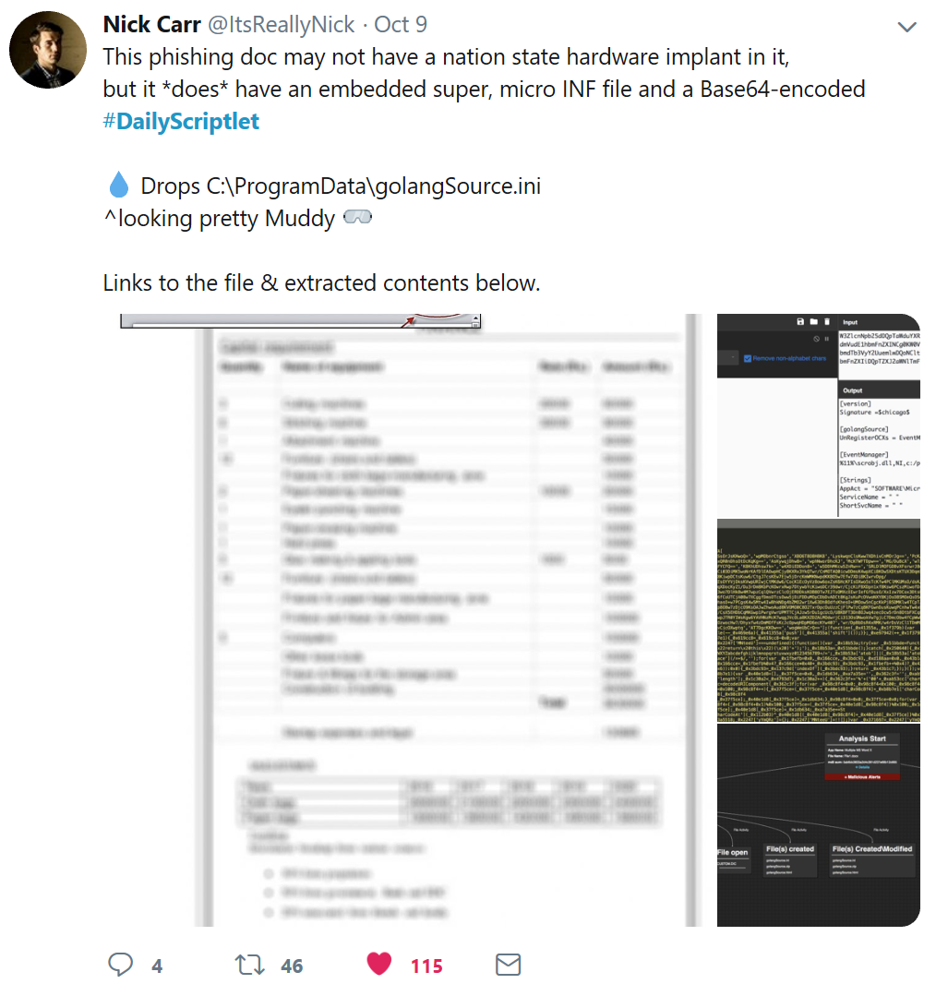
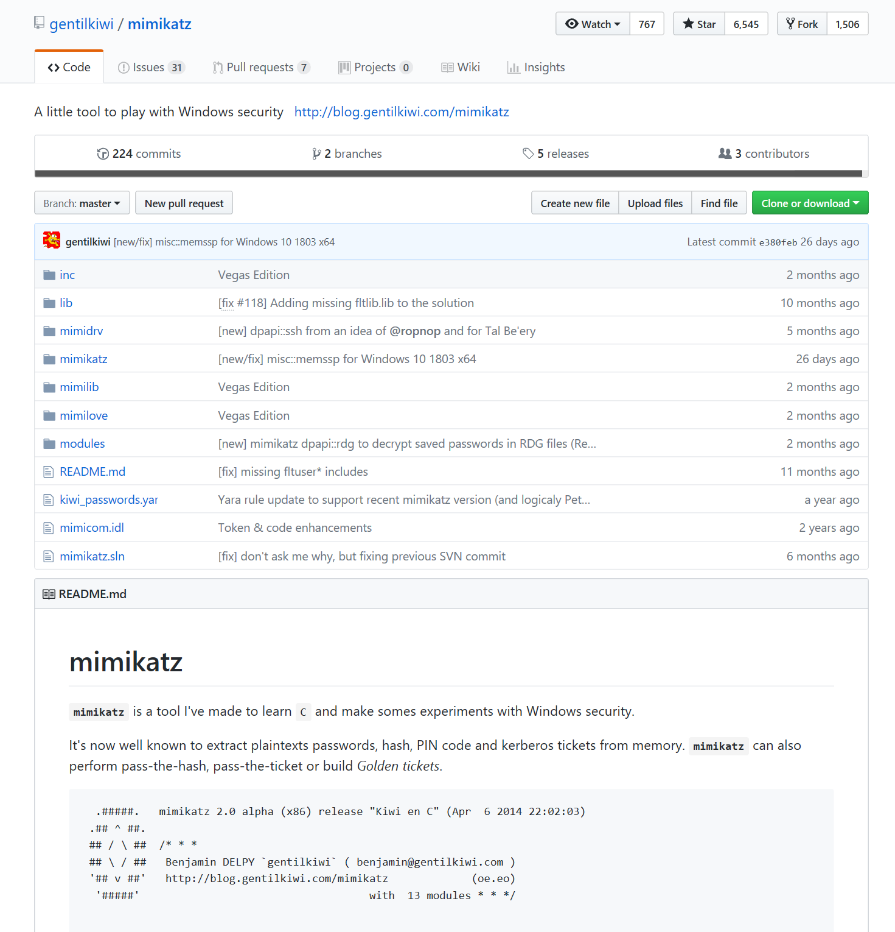
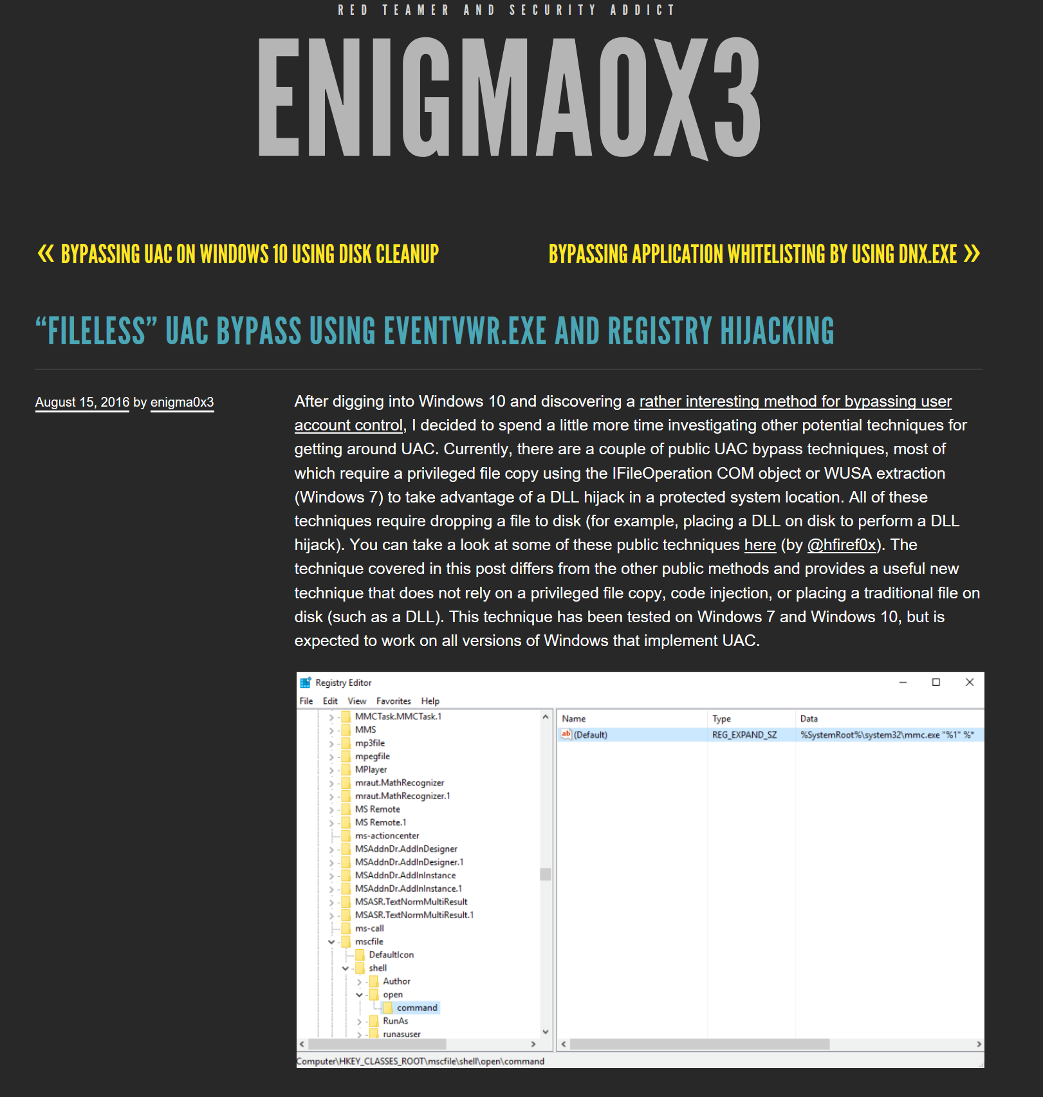
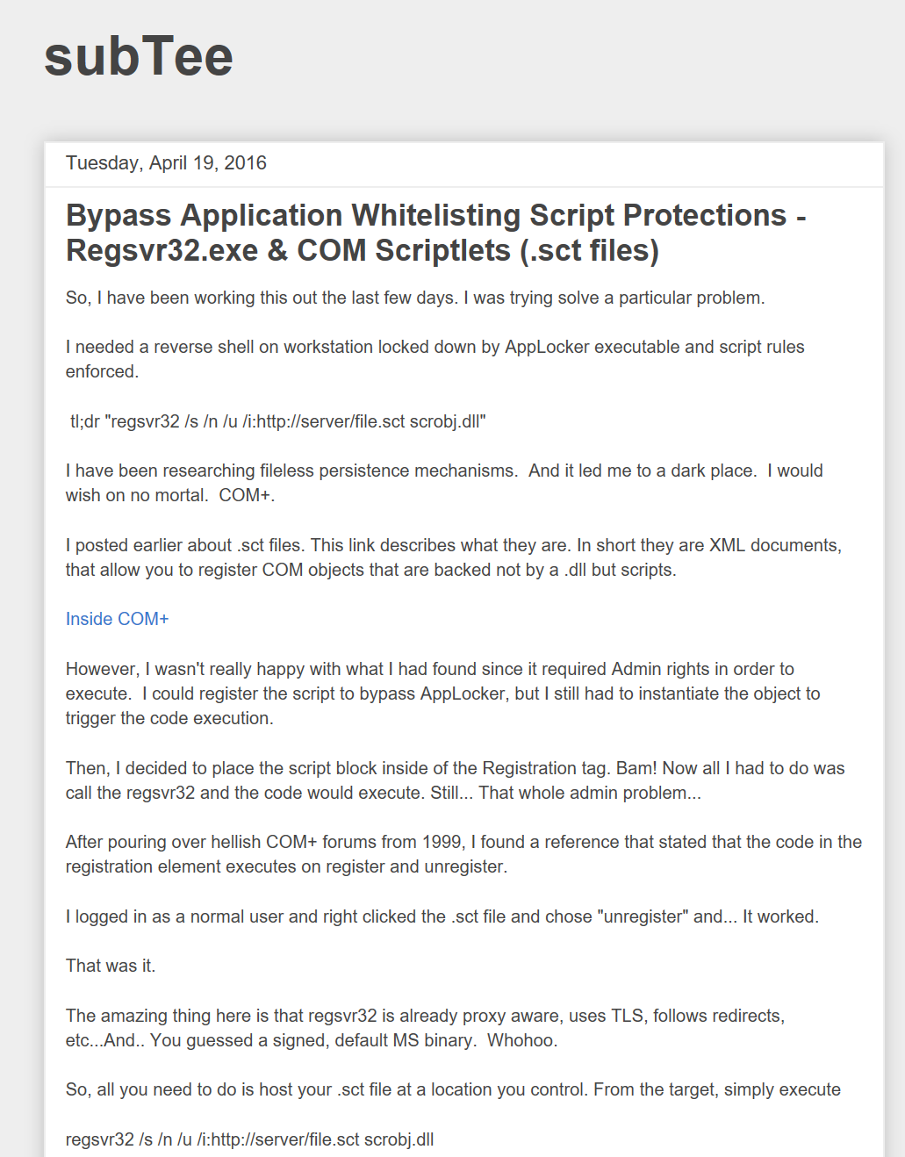
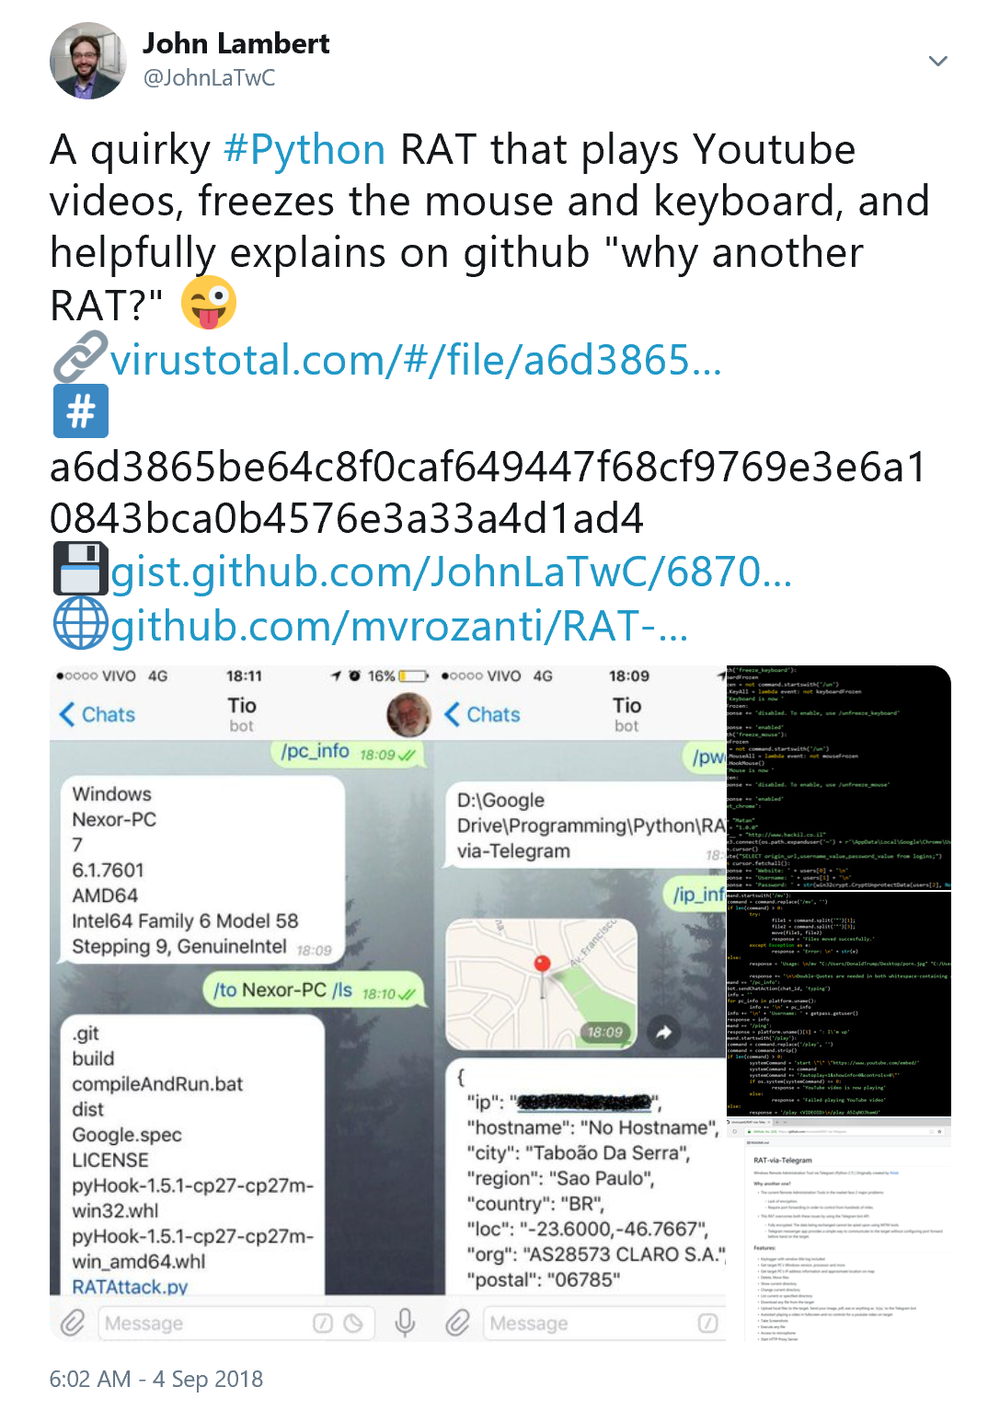
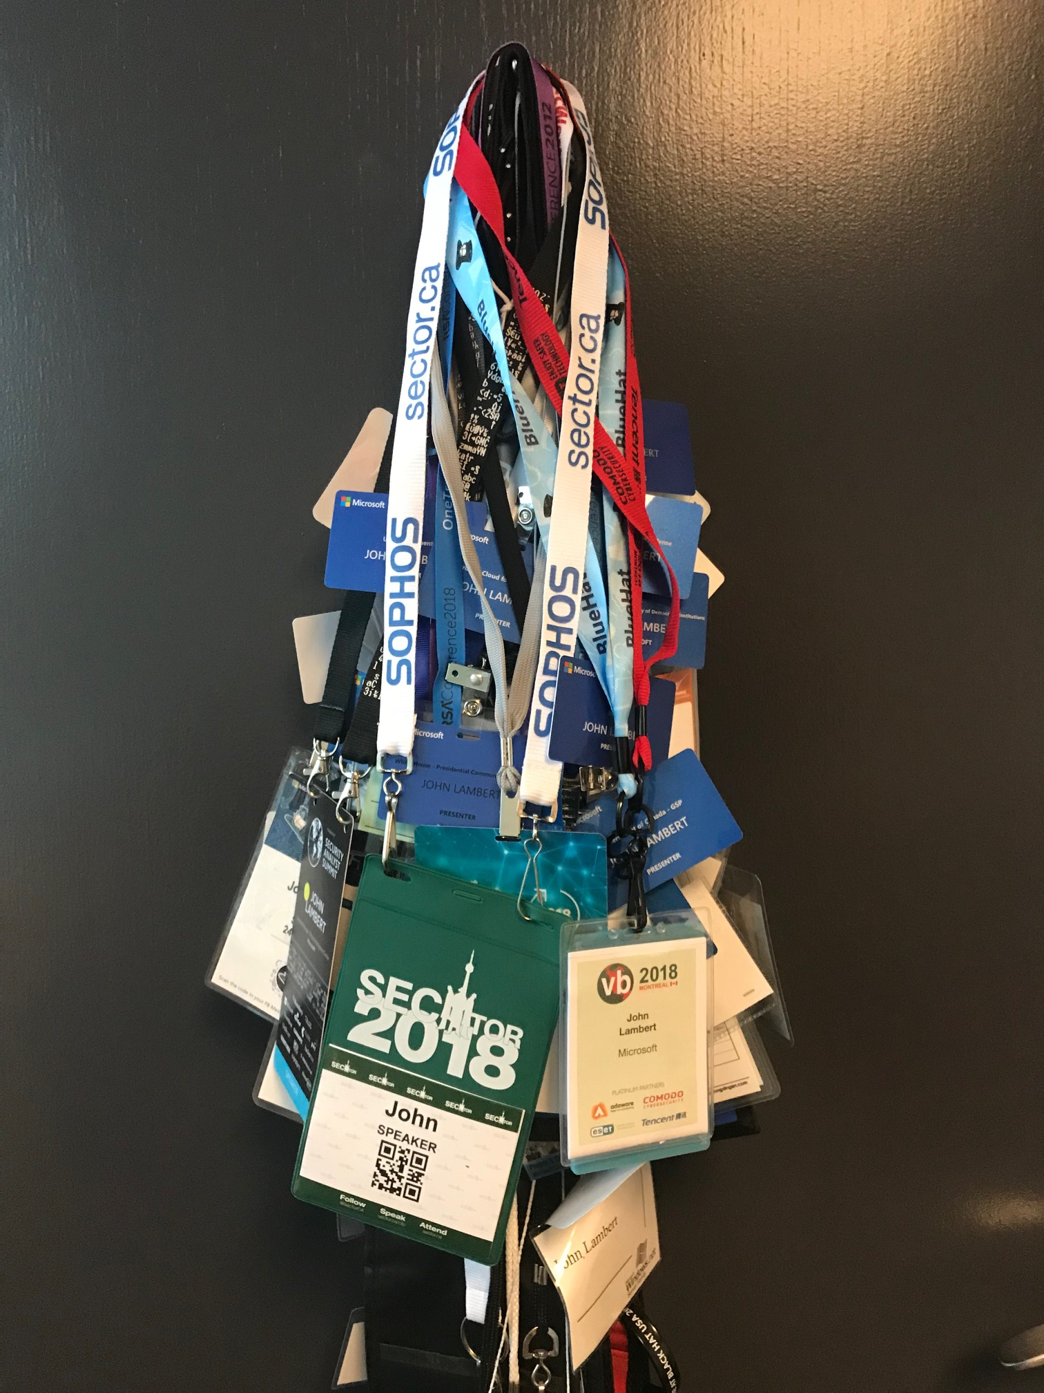
Community
Conferences
Blogs
Twitter
Creating Shared Tools
Mentoring
Individuals mentoring individuals
Teams buddying up with other teams
Orgs buddying up with other orgs
Industries buddying up with other industries

Slide 11
Organized Knowledge

Slide 12
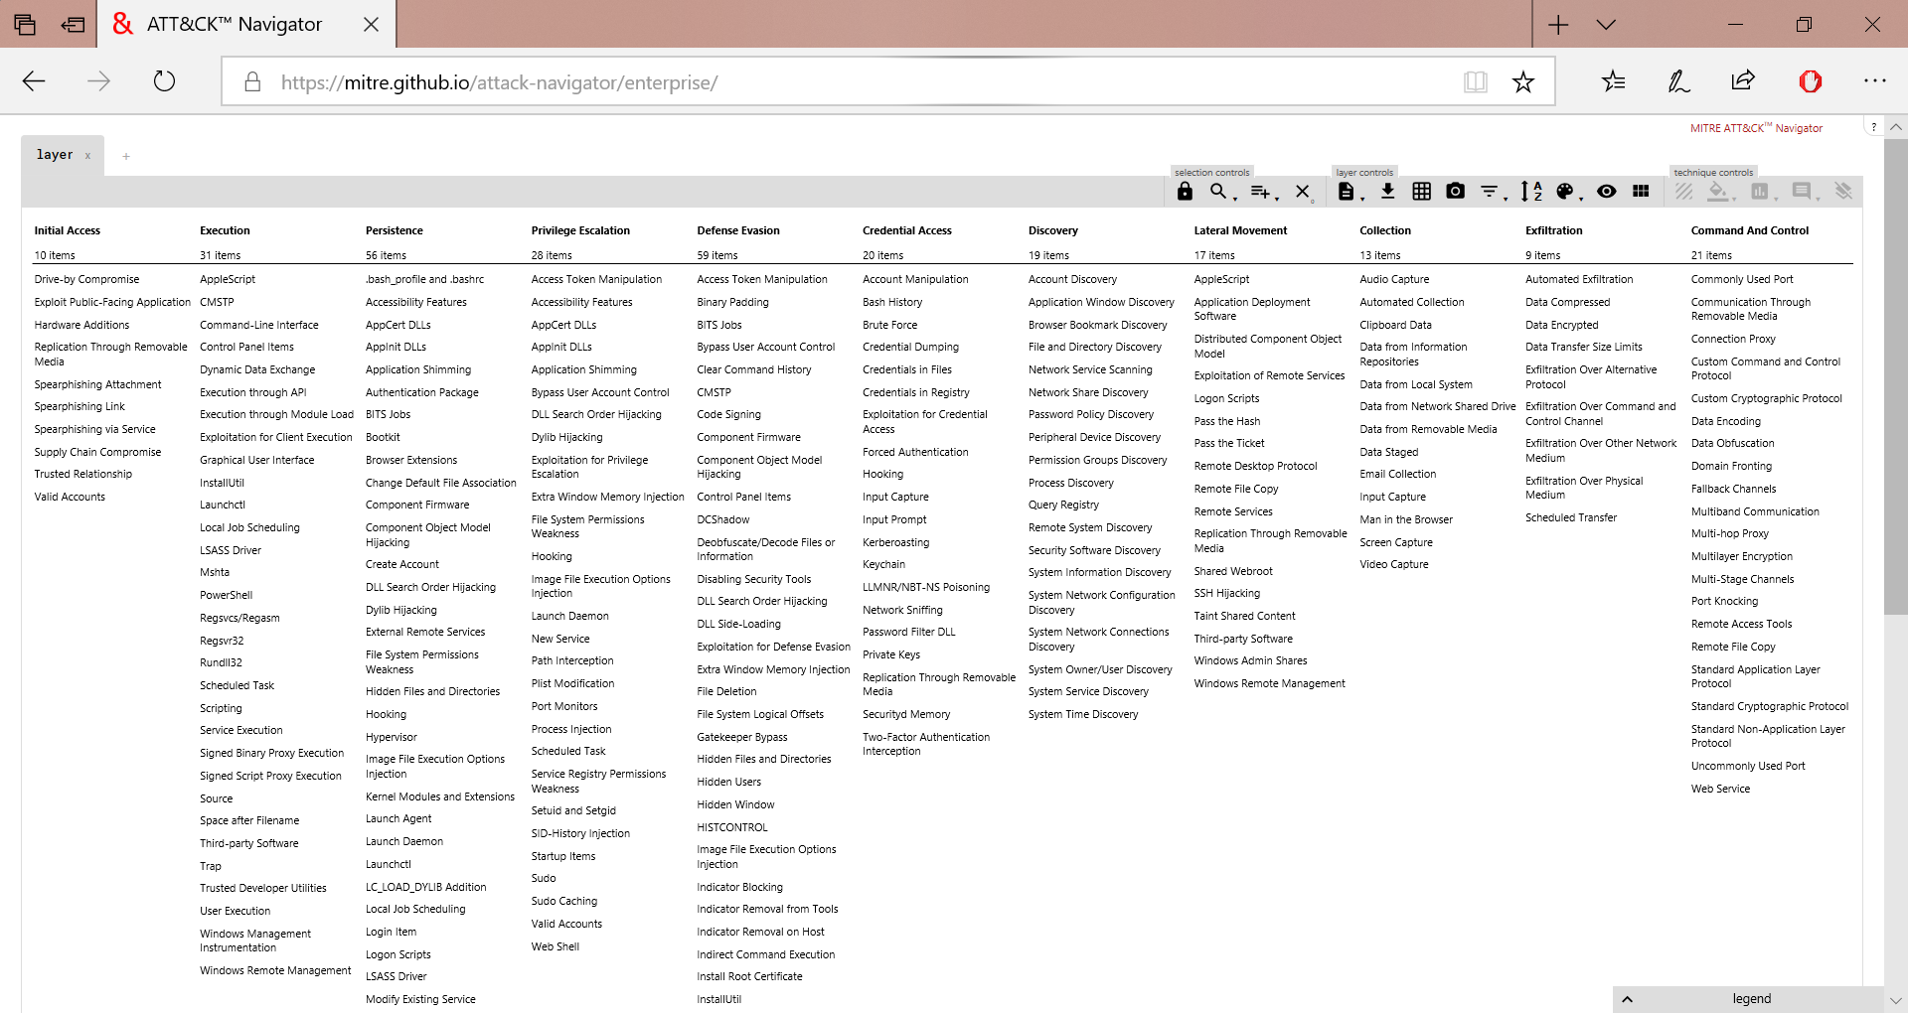
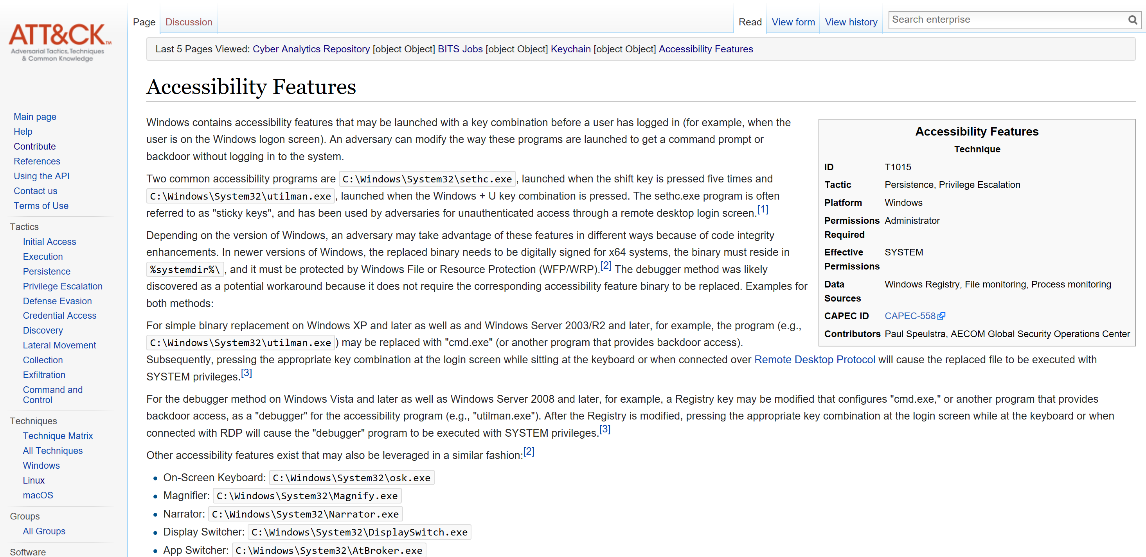
Knowledge

Slide 13
Activity Groups
H
hydrogen
1
He
helium
2
Li
lithium
3
Be
beryllium
4
B
boron
5
C
carbon
6
N
nitrogen
7
O
oxygen
8
F
fluorine
9
Ne
neon
10
Over 110 groups known to us
Over 70 full-fledged Activity Groups
Na
sodium
11
Mg
magnesium
12
Al
aluminium
13
Si
silicon
14
15
P
phosphorous
S
sulphur
16
Cl
chlorine
17
Ar
argon
18
K
potassium
19
Ca
calcium
20
Sc
scandium
21
Ti
titanium
22
V
vanadium
23
Cr
chromium
24
Mn
manganese
25
Fe
iron
26
Co
cobalt
27
Ni
nickel
28
Cu
copper
29
Zn
zinc
30
Ga
galium
31
Ge
geramanium
32
33
As
arsenic
Se
selenium
34
Br
bromine
35
Kr
krypton
36
Rb
rubidium
37
Sr
strontium
38
Y
yttrium
39
Zr
zirconium
40
Nb
niobium
41
Mo
molybdenum
42
Tc
technetium
43
Ru
ruthenium
44
Rh
rhodium
45
Pd
palladium
46
Ag
silver
47
Cd
cadminium
48
In
indium
49
Sn
tin
50
51
Sb
antimoney
Te
tellurium
52
I
iodine
53
Xe
xenon
54
Cs
caesium
55
Ba
barium
56
Hf
hafnium
72
Ta
tantalum
73
W
tungsten
74
Re
rhenium
74
Os
osminium
76
Ir
iridium
77
Pt
platinum
78
Au
gold
79
Hg
mercury
80
Tl
thallium
81
Pb
lead
82
83
Bi
bismuth
Po
polonium
84
At
astatine
85
Rn
radon
86
Rf
rutherfordium
112
104
Db
dubnium
105
Sg
seaborgium
106
Bh
bohrium
107
Hs
hassium
108
Mt
meitnerium
109
Ds
darmstadtium
110
Rg
goentgenium
111
Cn
copernicium
Nh
nihonium
113
Fl
flerovium
114
Mc
moscovium
115
Lv
livermorium
116
117
Ts
tennessine
Og
oganesson
Fr
francium
118
Fr
francium
87
Ra
radium
Ra
radium
88
La
lanthanum
57
Ce
cerium
58
Pr
praseodymium
59
Nd
neodymium
60
Pm
promethium
61
Sm
samarium
62
Eu
europium
63
Gd
gadolinium
64
Tb
terbium
65
Dy
dysprosium
66
Ho
holmium
67
Er
erbium
68
Tm
thulium
69
Yb
ytterbium
70
Lu
lutetium
71
Ac
actinium
89
Th
thorium
90
Pa
protactinium
91
U
uranium
92
Np
neptunium
93
Pu
plutonium
94
Am
americium
95
Cm
curium
96
Bk
berkelium
97
Cf
californium
98
Es
einsteinium
99
Fm
fermium
100
Md
mendelevium
101
No
nobelium
102
Lr
lawrencium
103

Slide 14
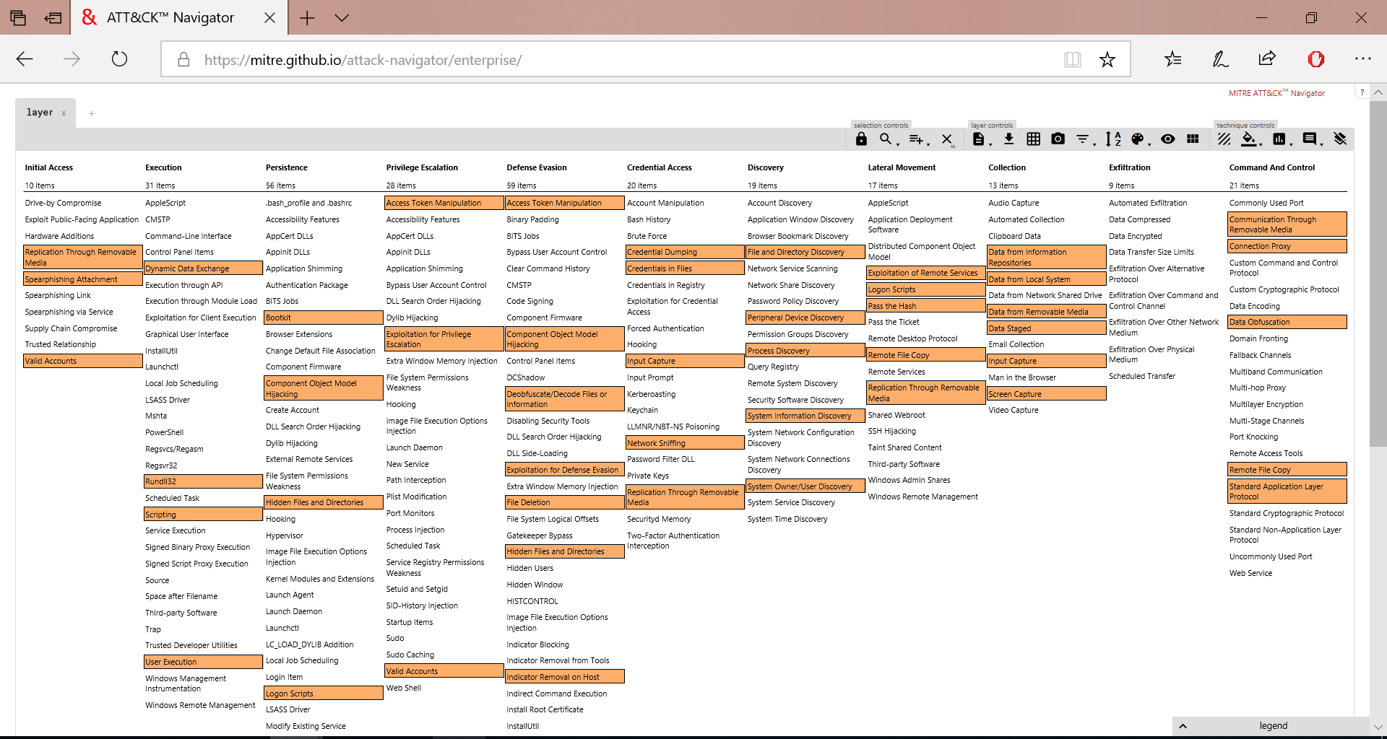
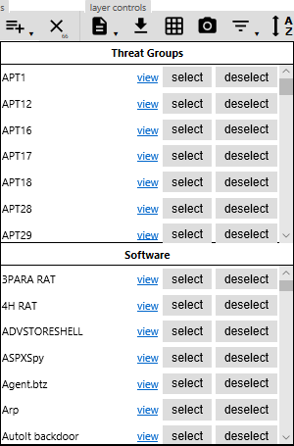

Slide 15
Executable Know-how

Slide 16
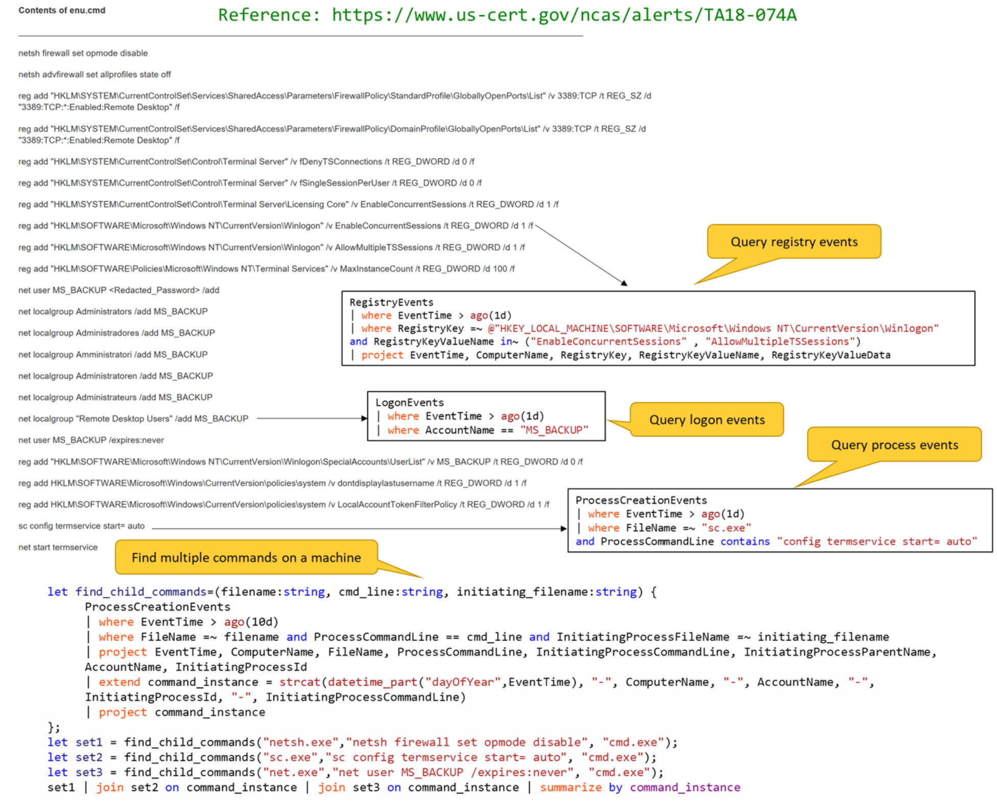
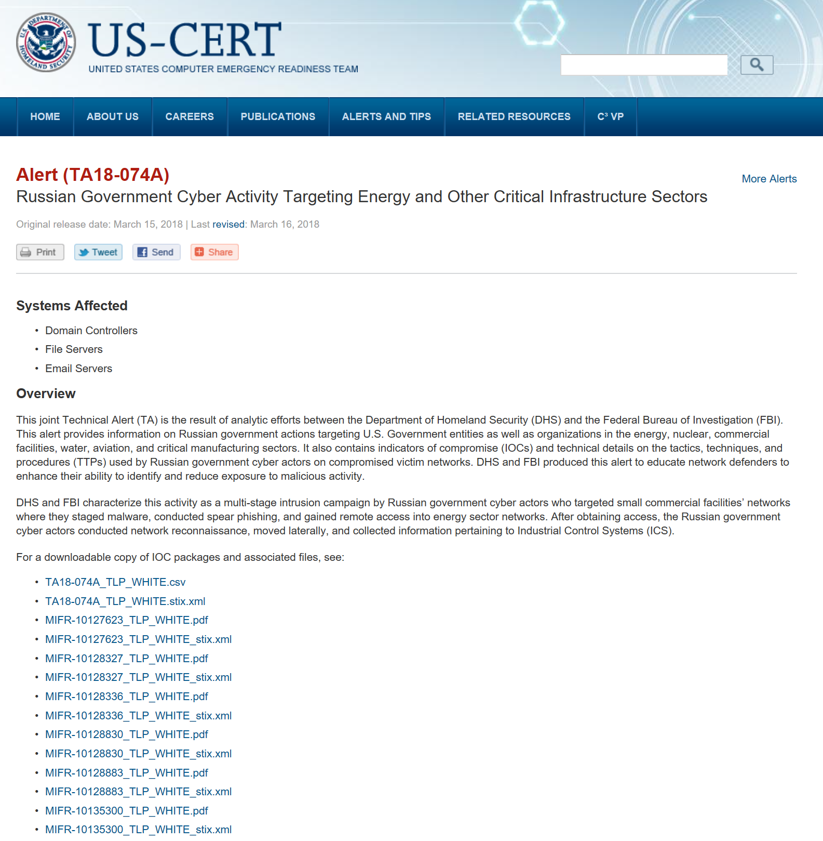

Slide 17
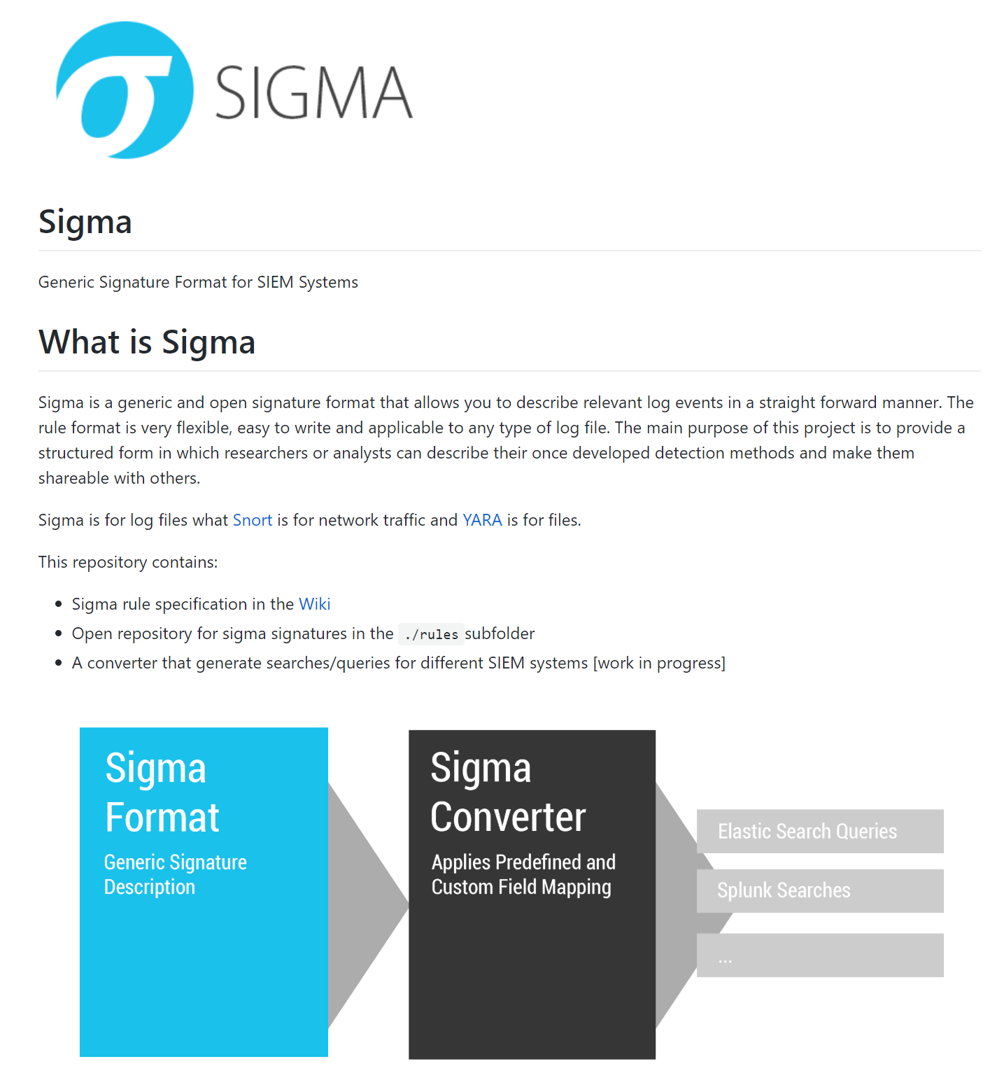
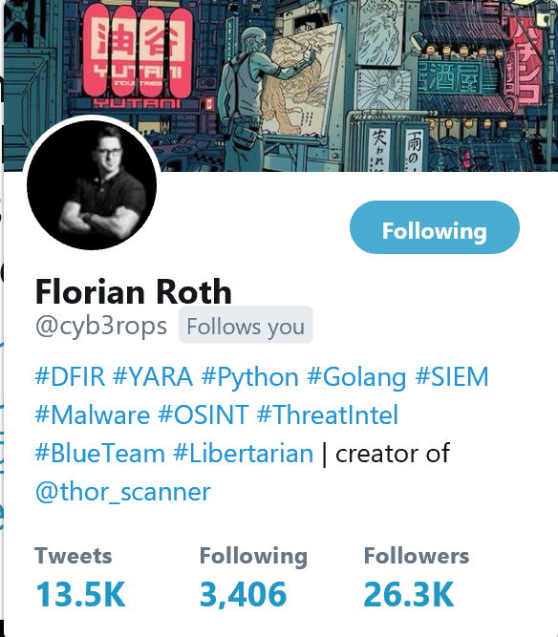

Slide 18
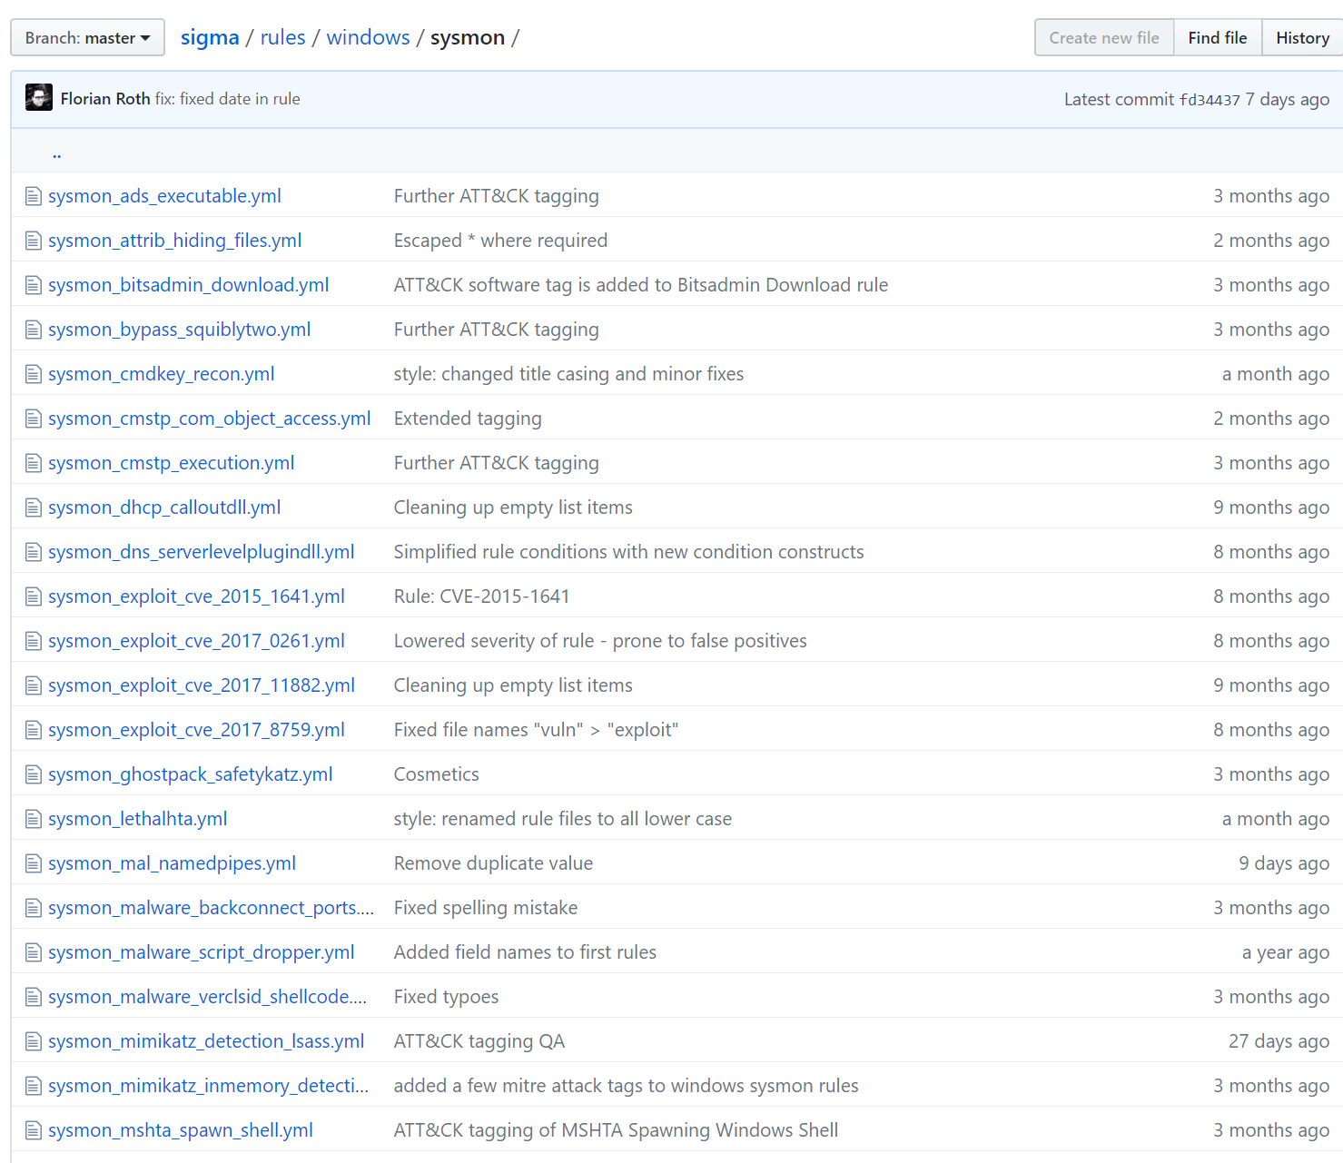
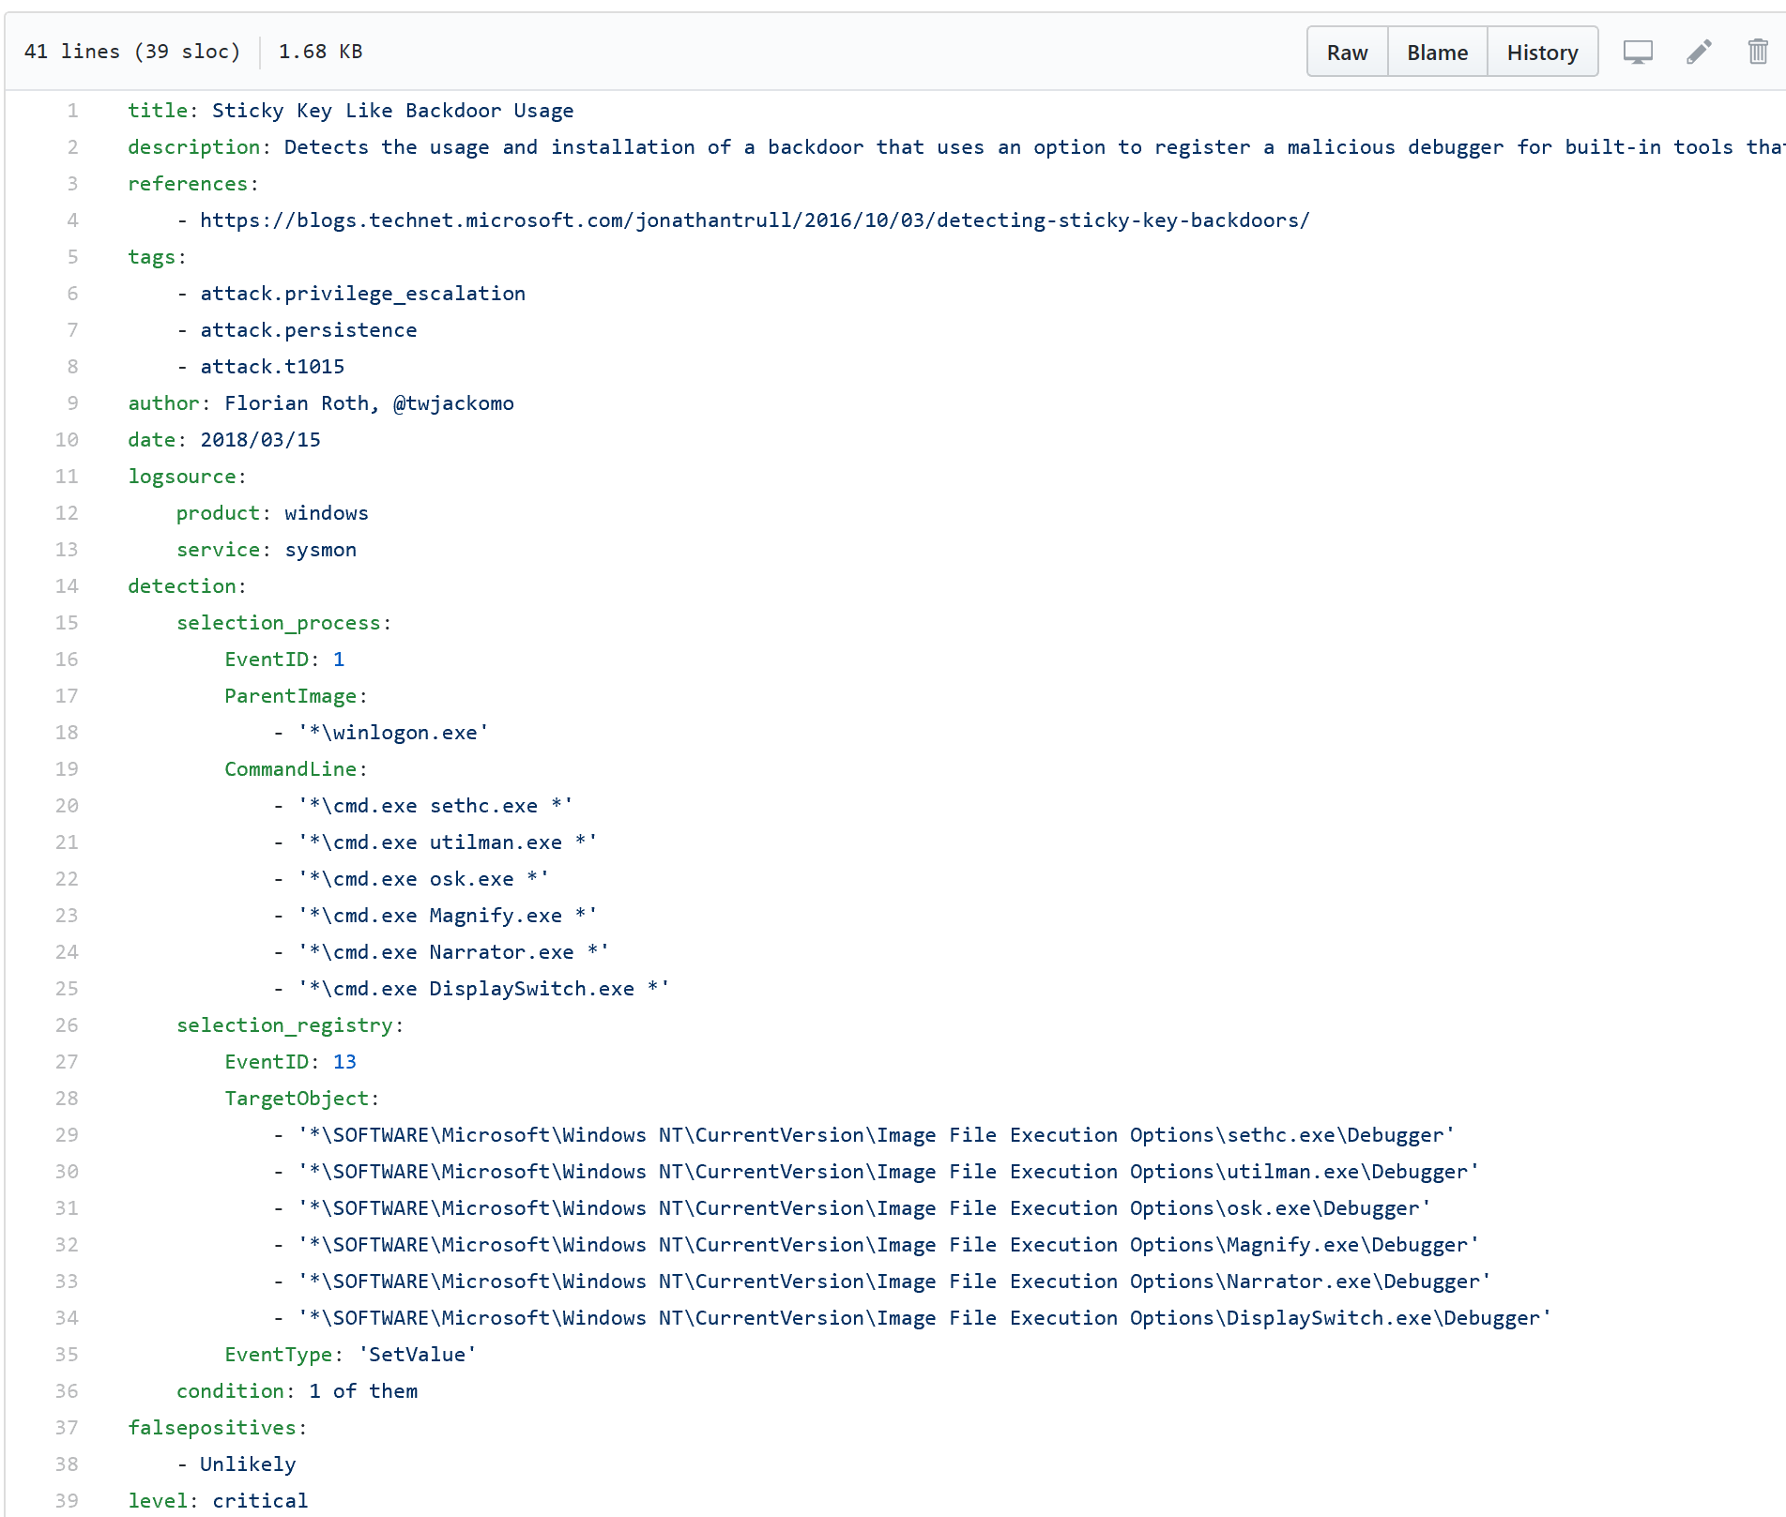
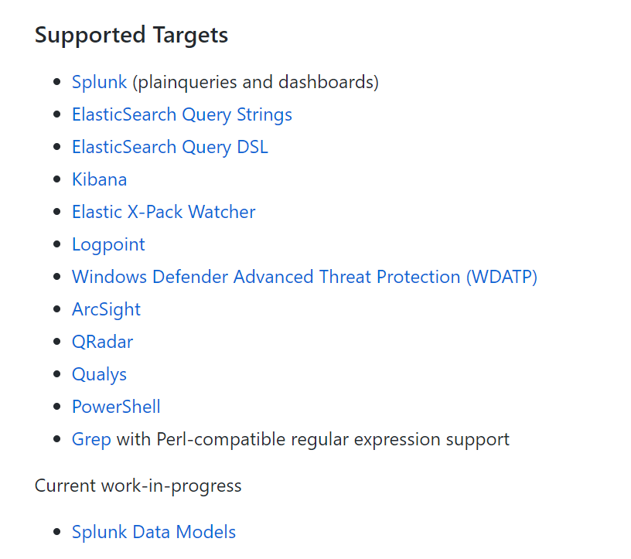
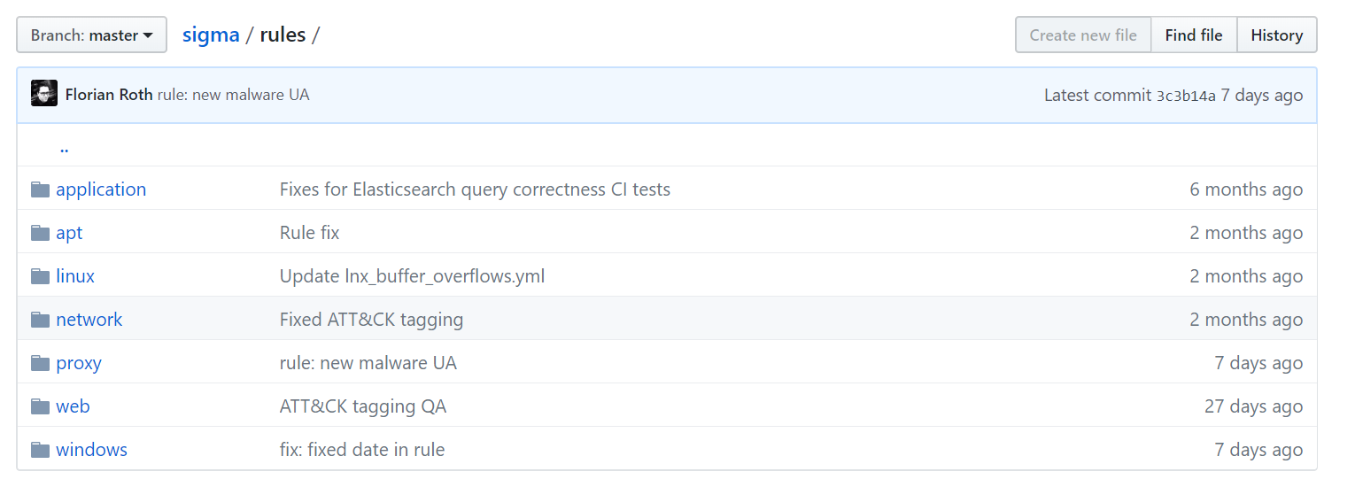
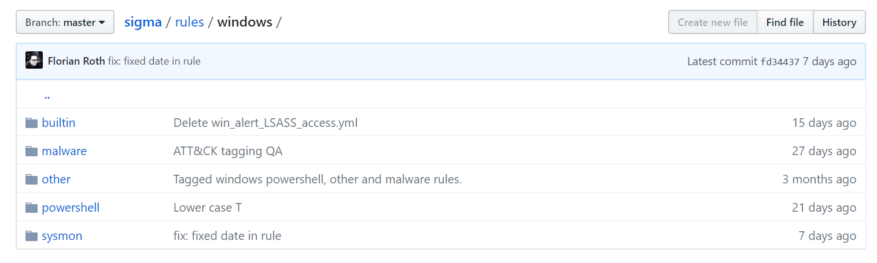

Slide 19
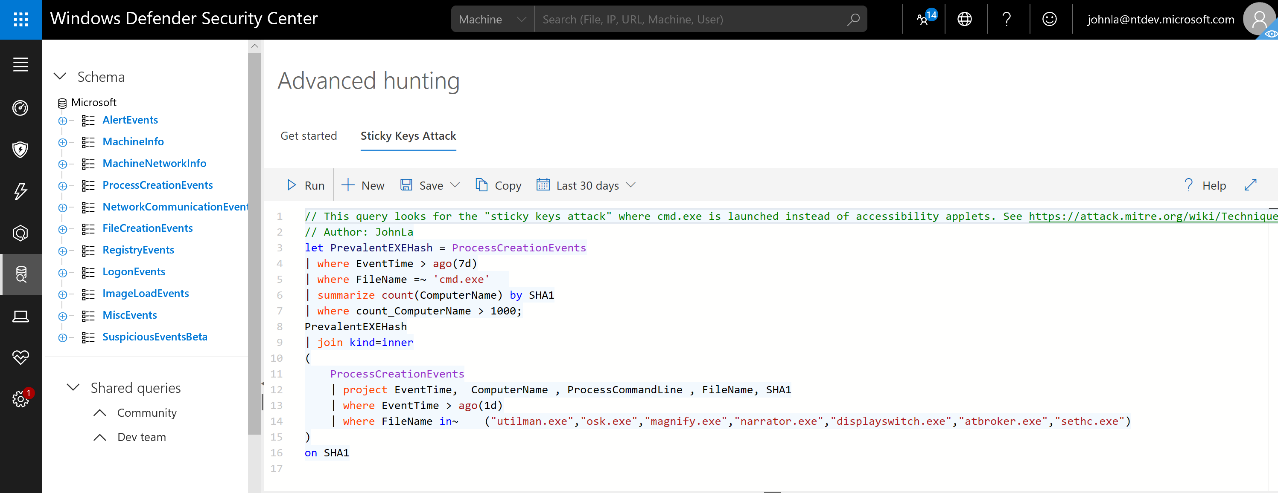
Translation

Slide 20
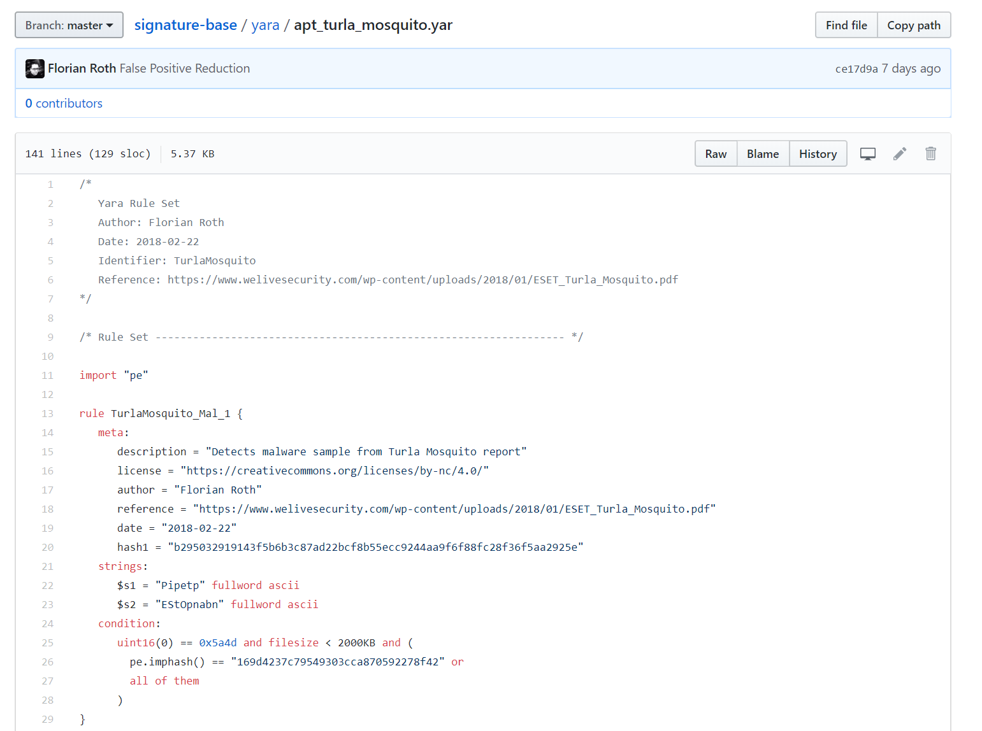
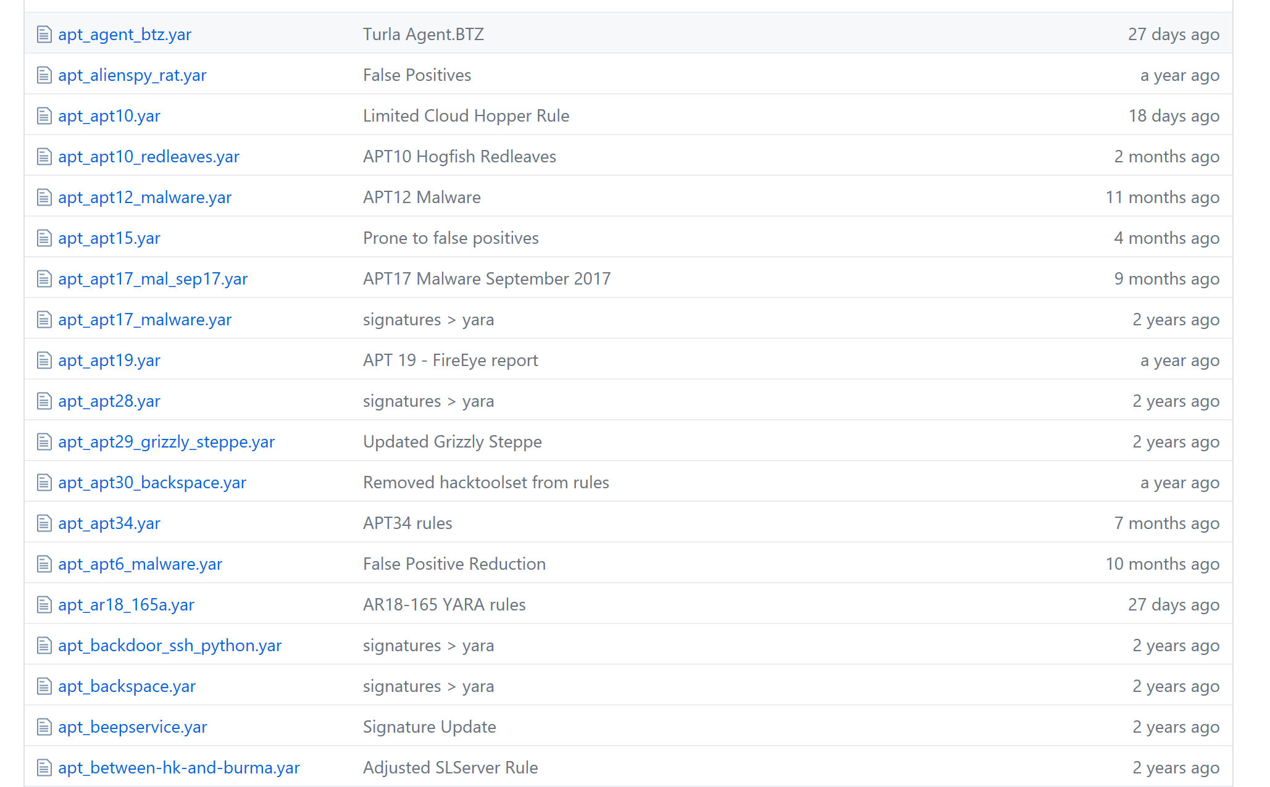
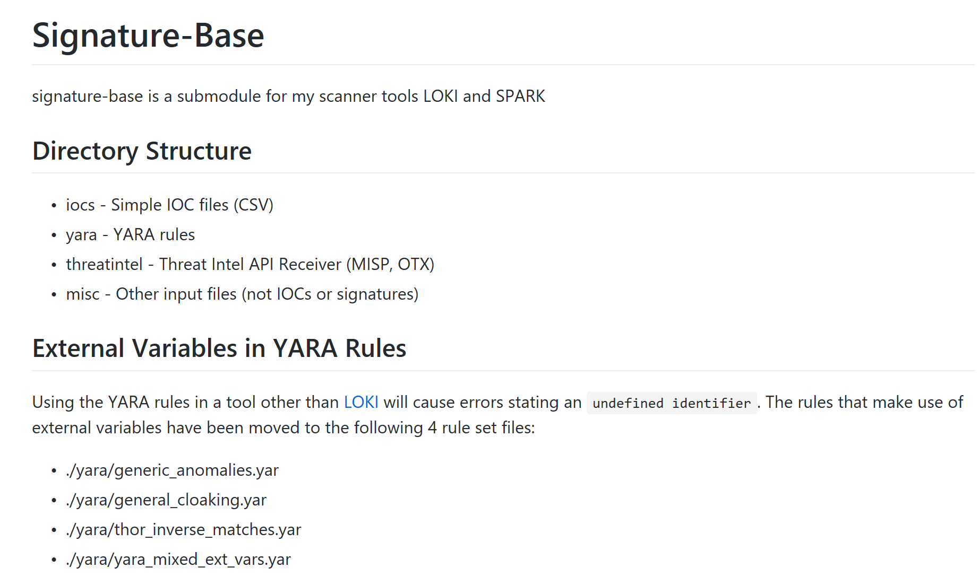

Slide 21
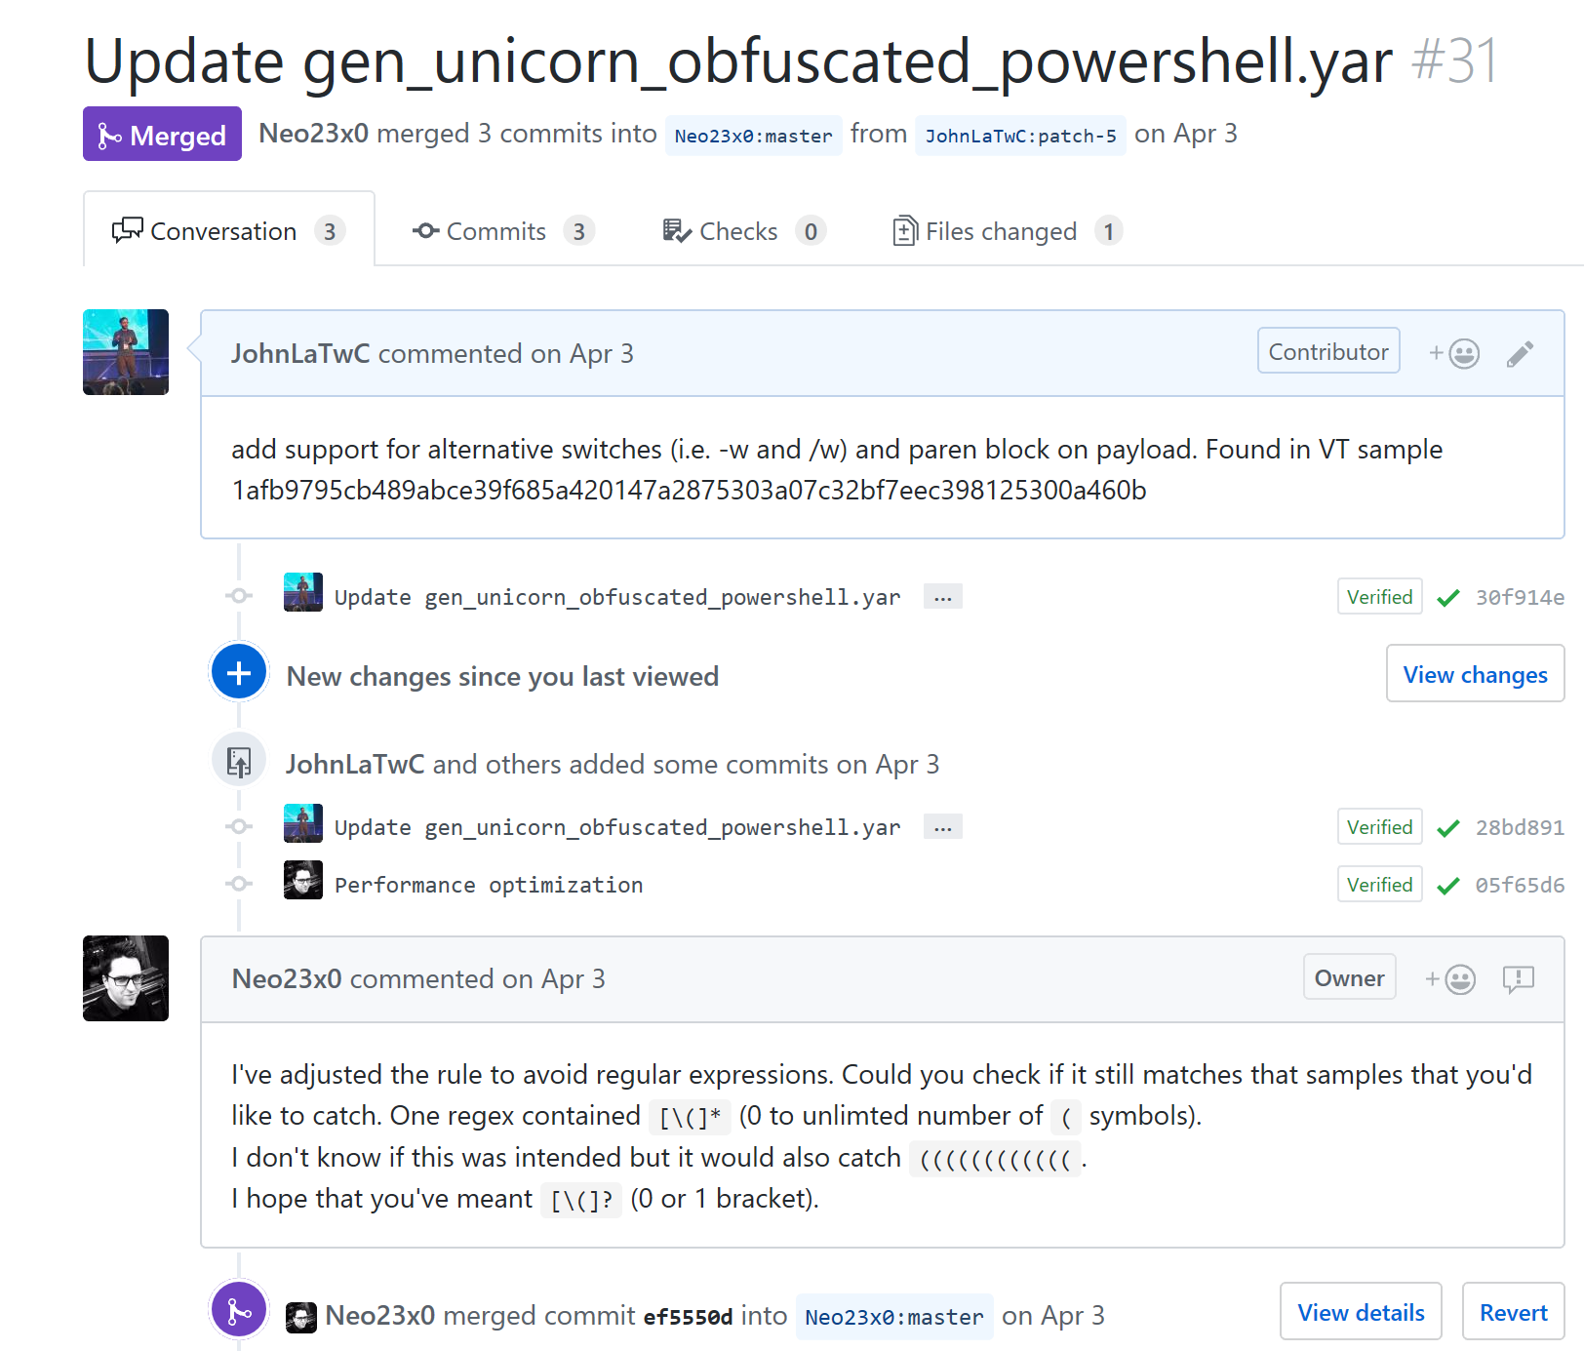
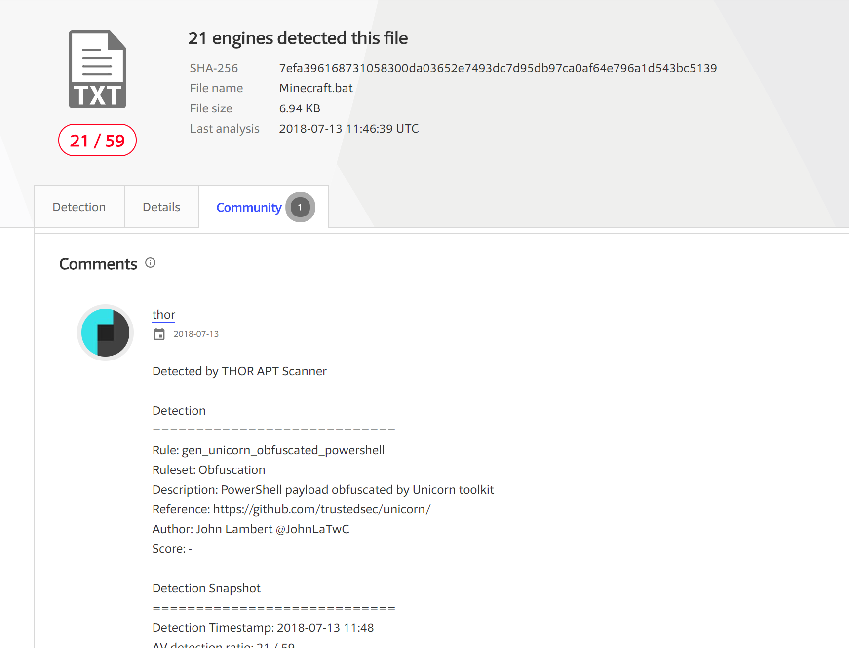
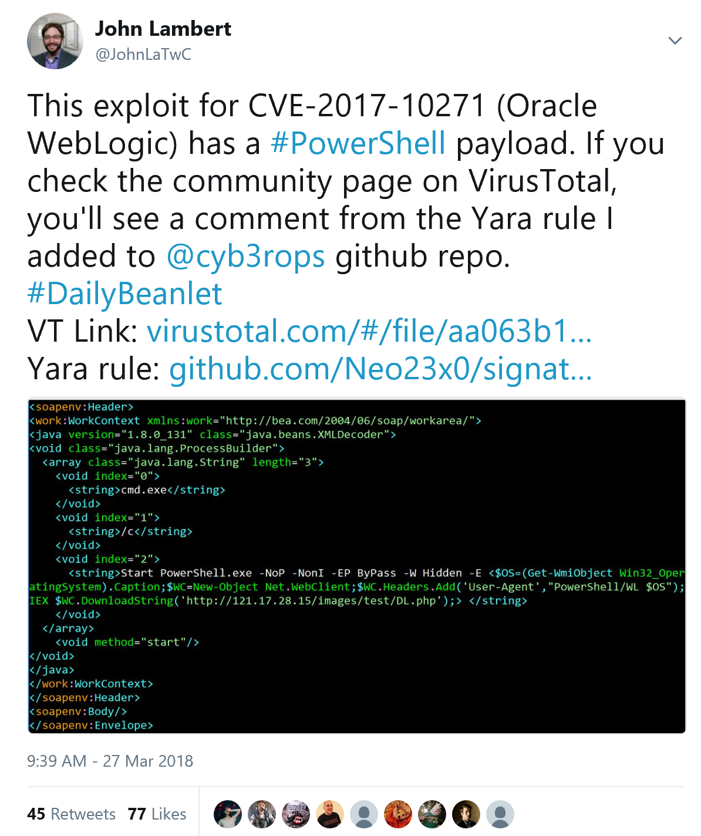
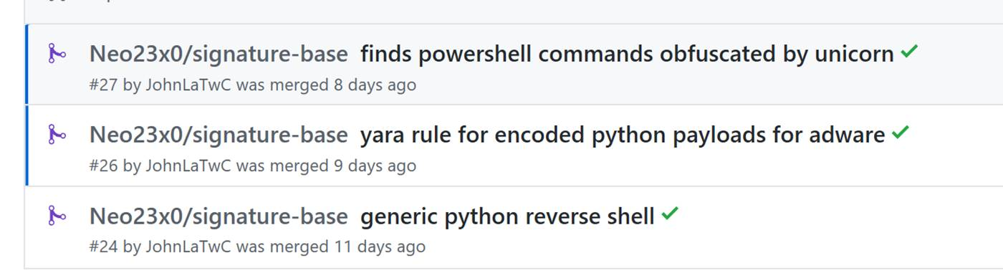
Contributor Friendly

Slide 22
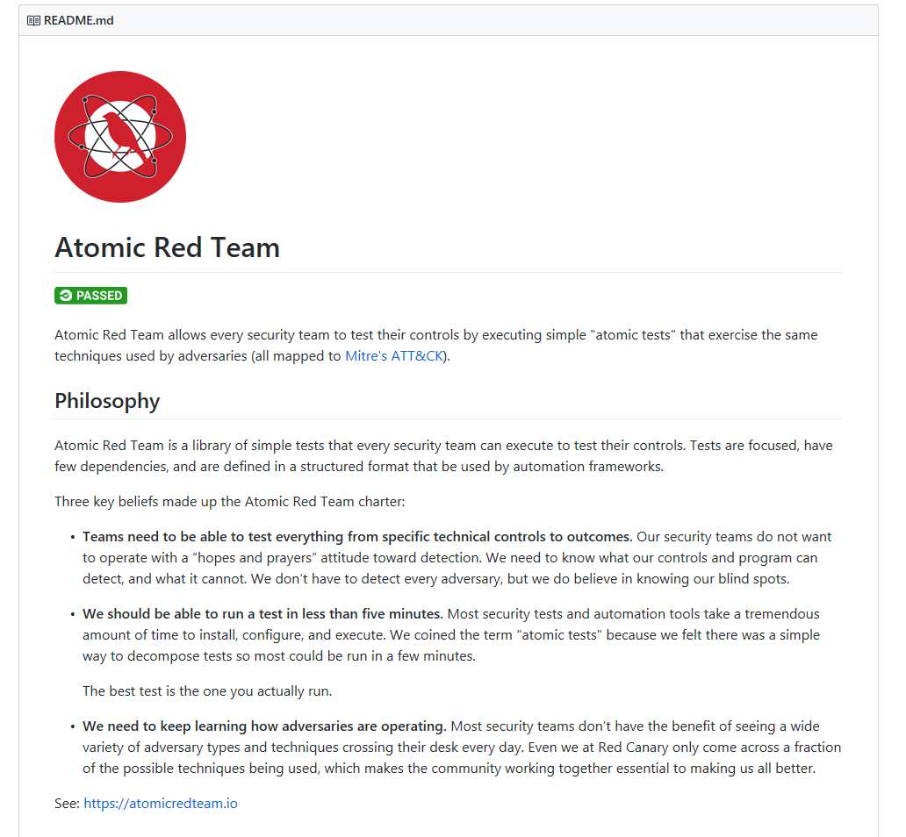
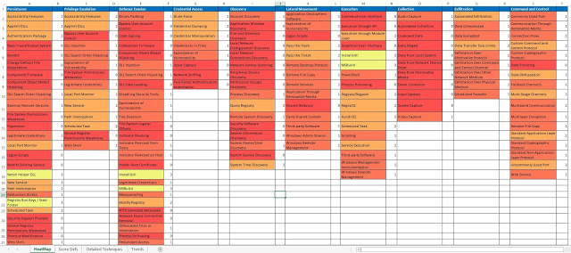
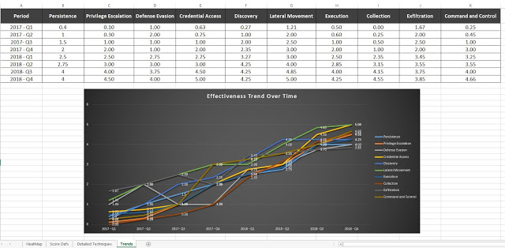
Testing and Validation
https://cyberwardog.blogspot.com/2017/07/how-hot-is-your-hunt-team.html.
https://github.com/redcanaryco/atomic-red-team

Slide 23
Repeatable Analysis

Slide 24
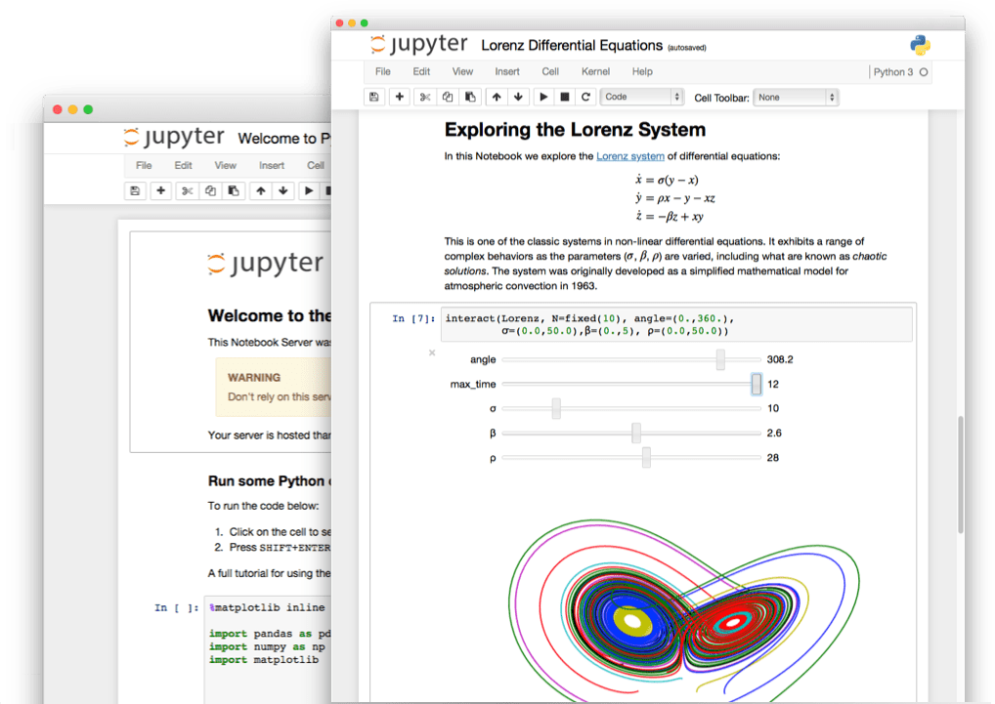
Jupyter

Slide 25
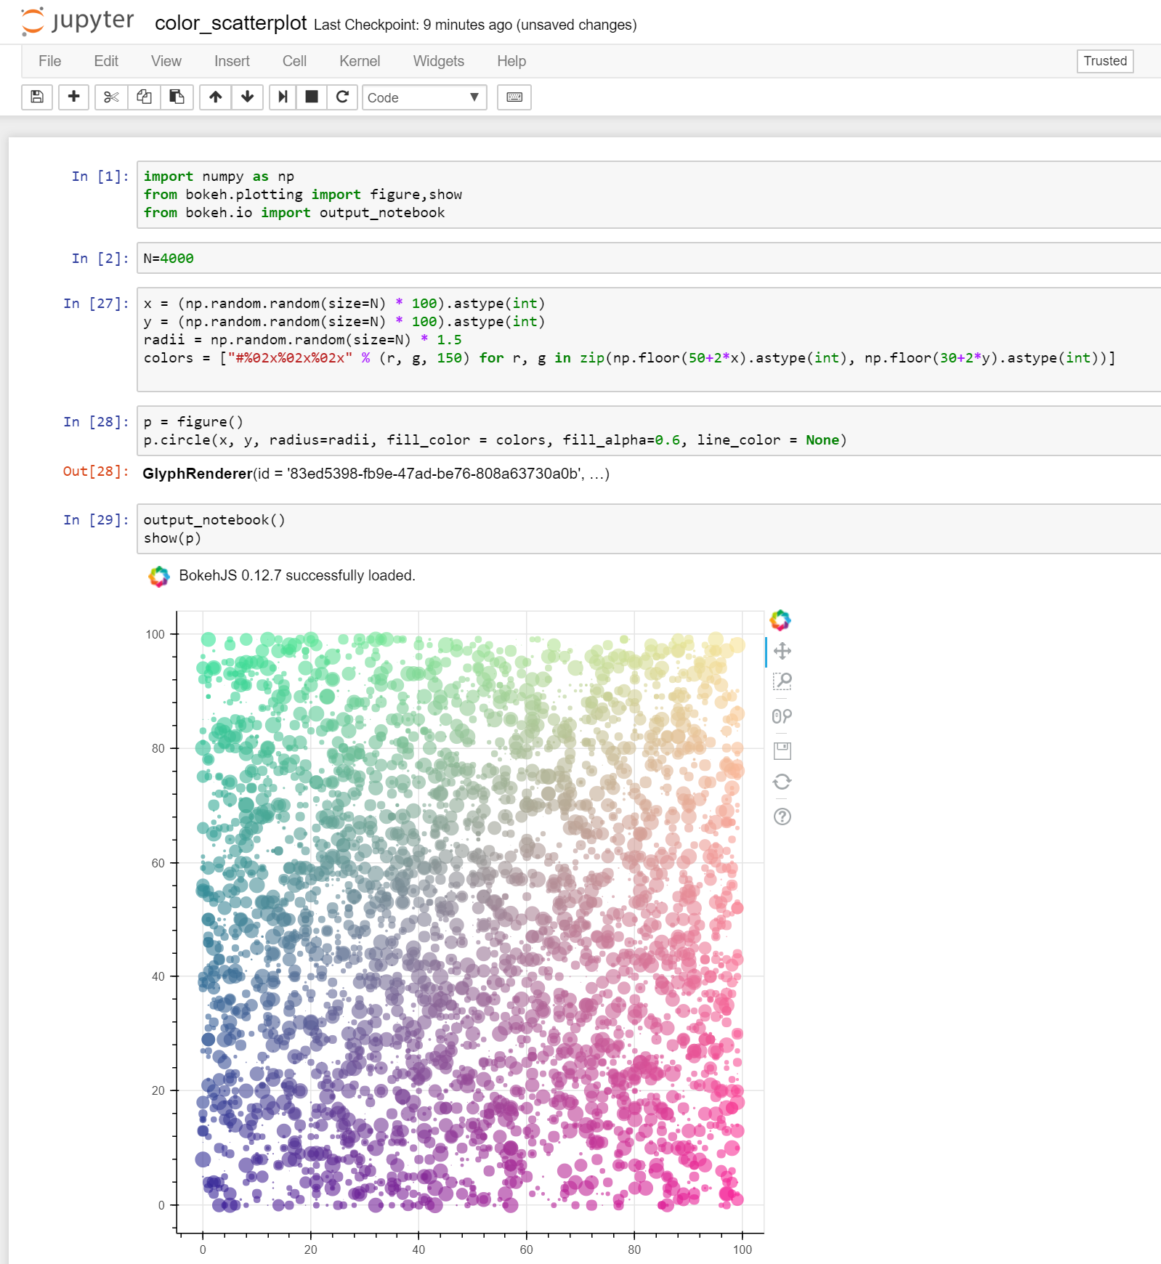
Notebooks
Vibrant ecosystem
Yearly conference
2.6 million notebooks on github
Local and Cloud supported:
AWS SageMaker
Google Data Lab
Azure Notebooks
Shareable
Re-runnable
Extensible

Slide 26
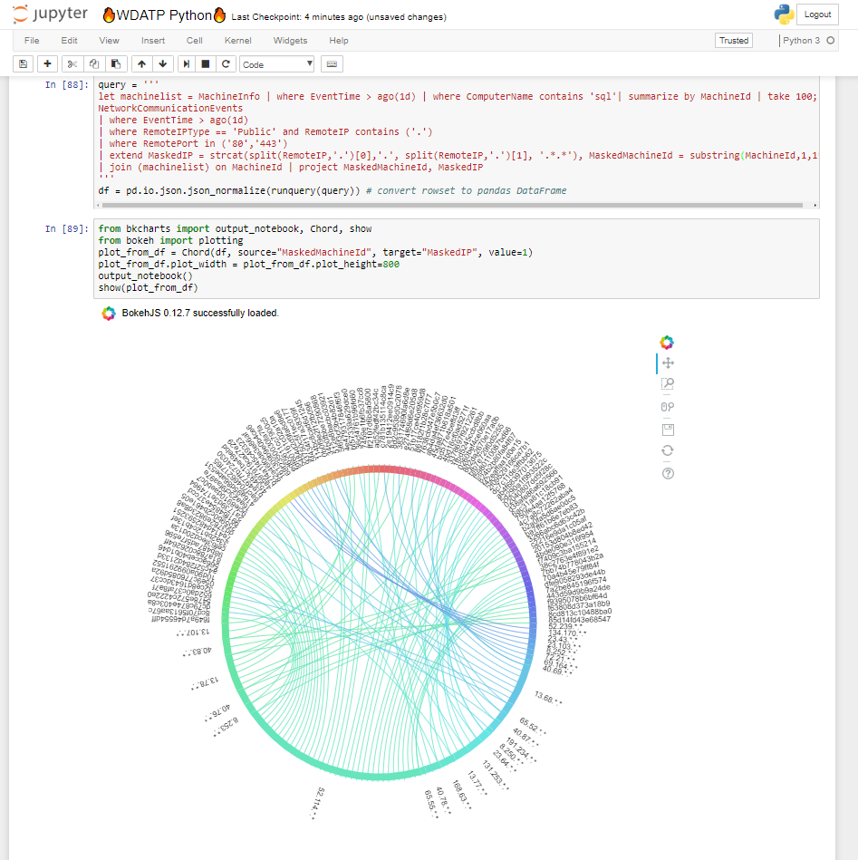
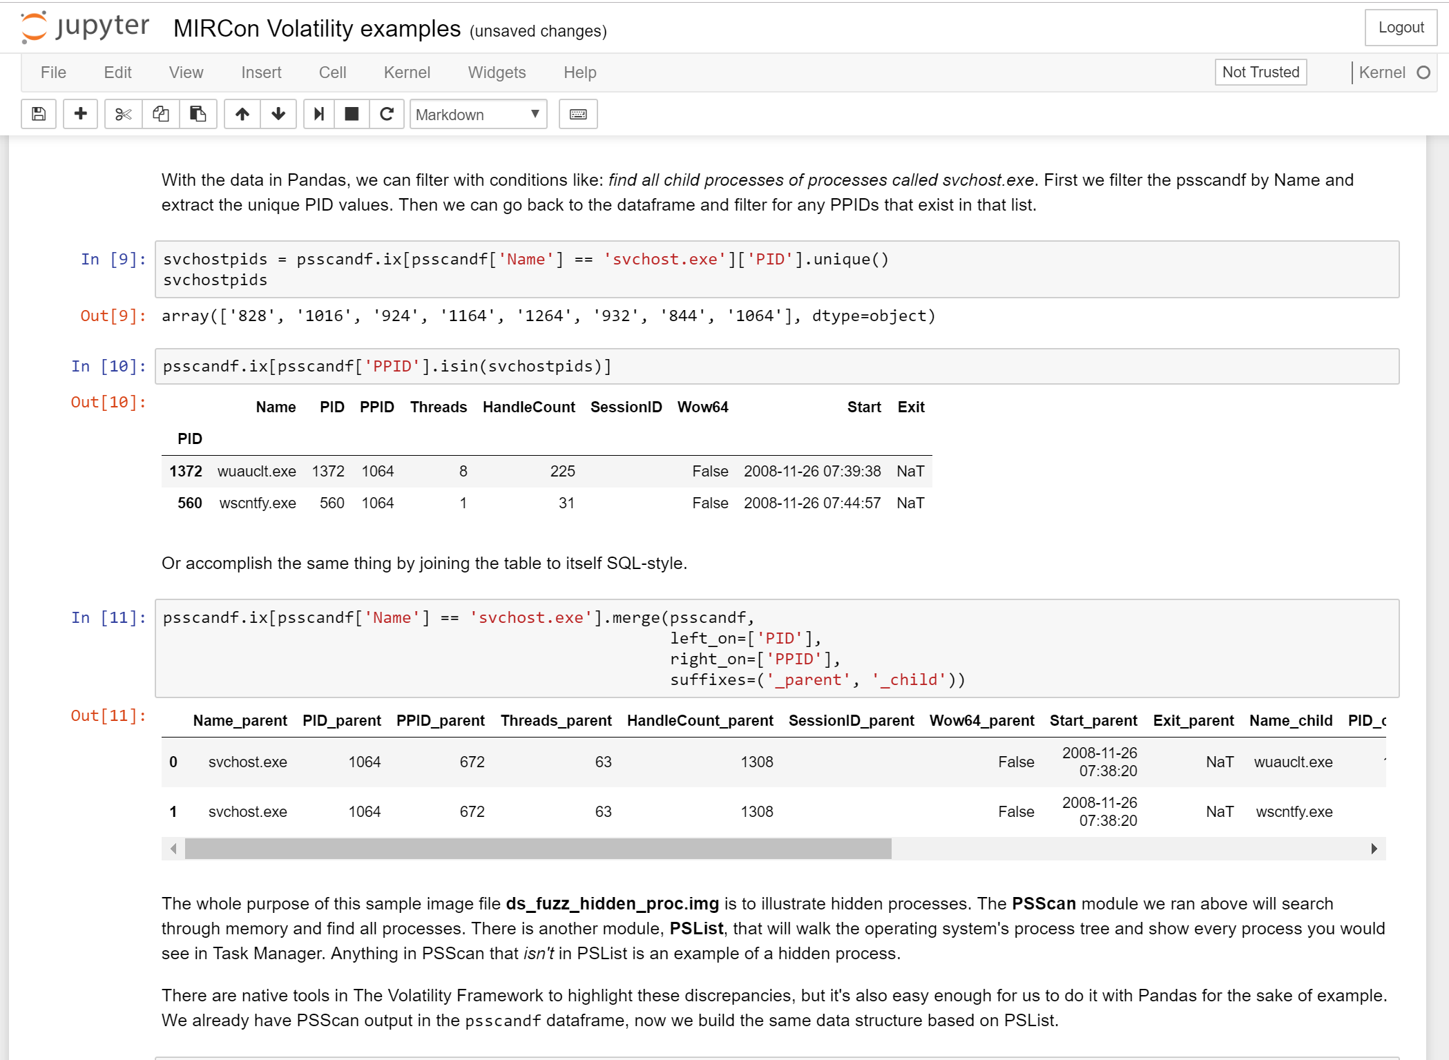
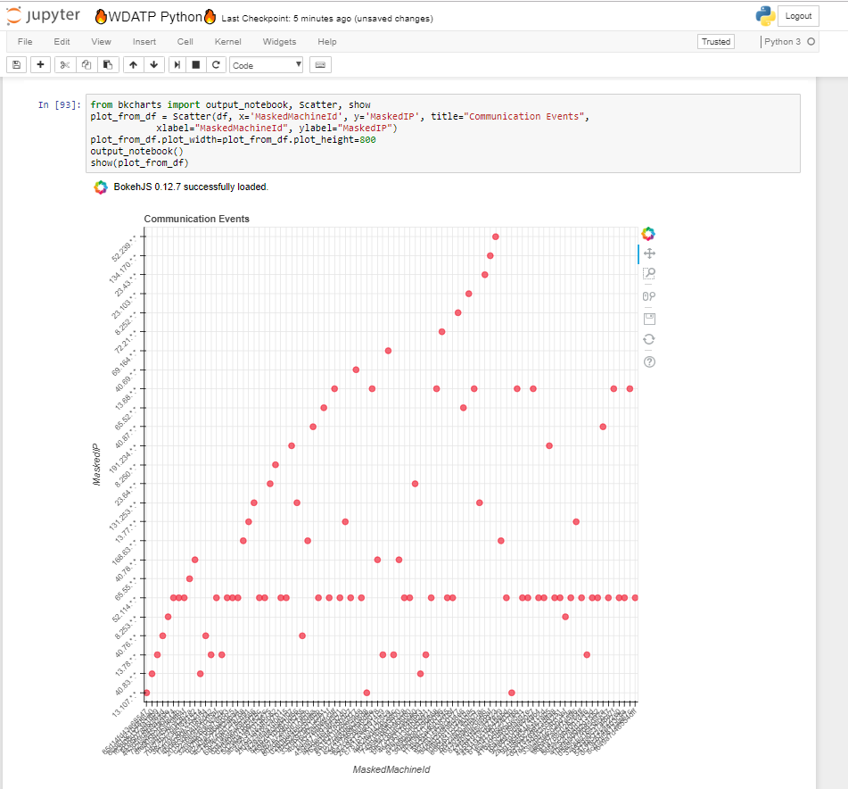
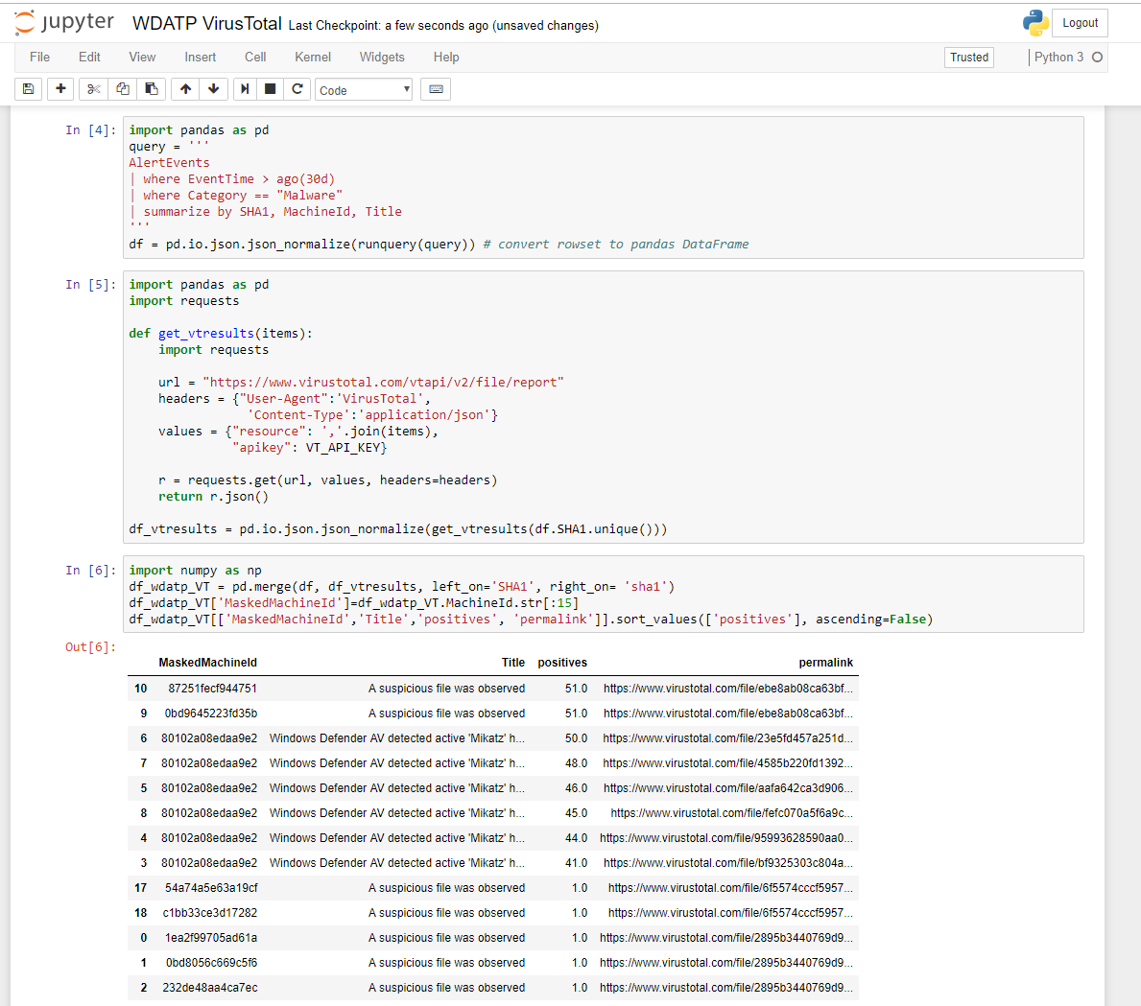
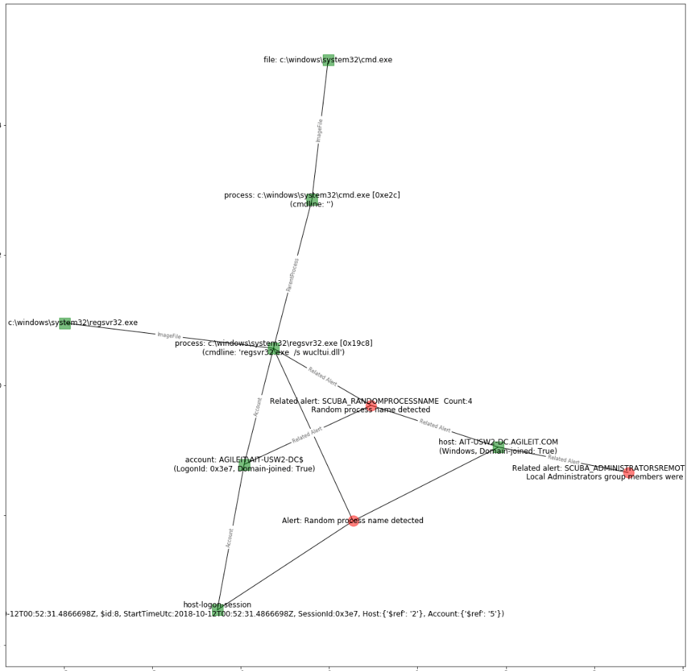
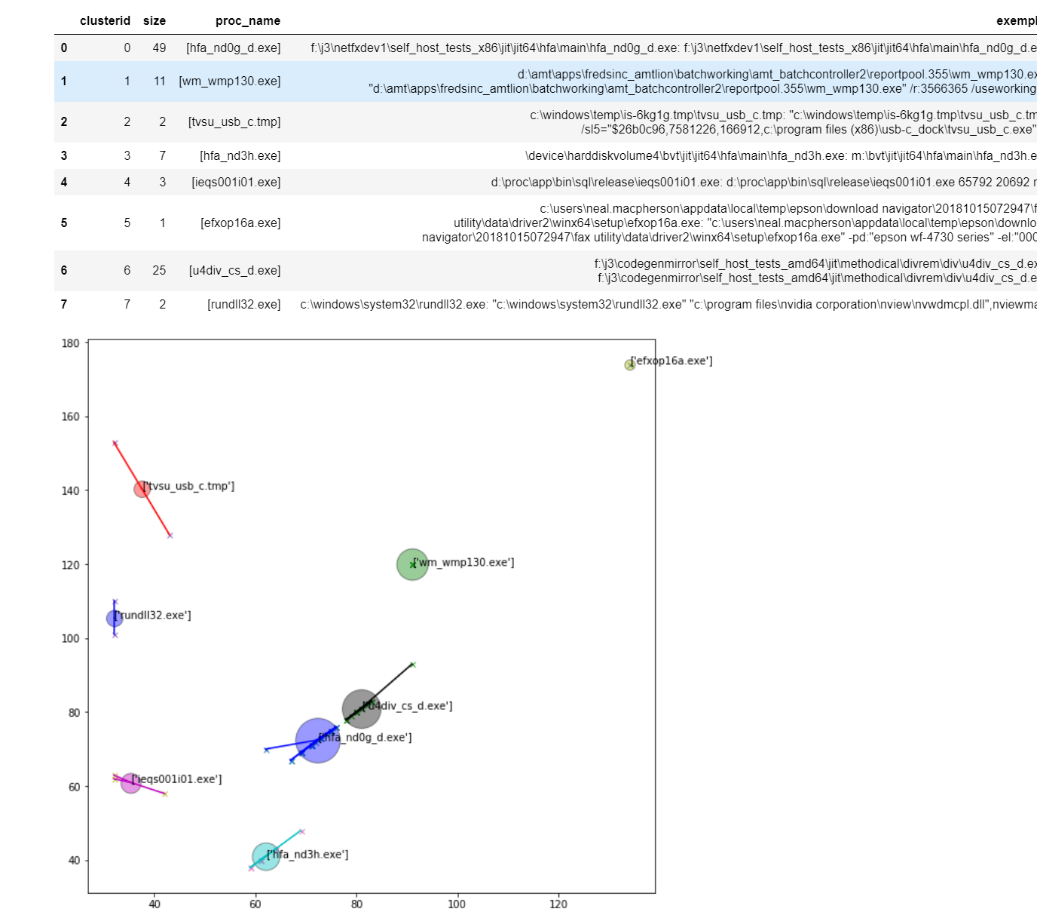
https://github.com/erichutchins/mircon2013

Slide 27
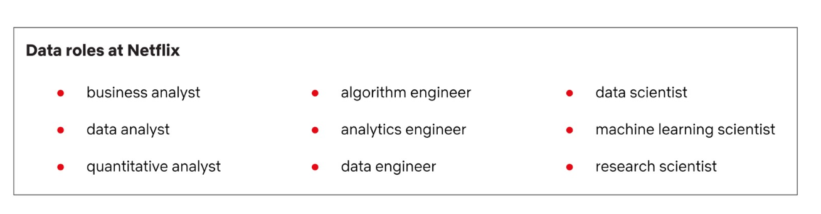
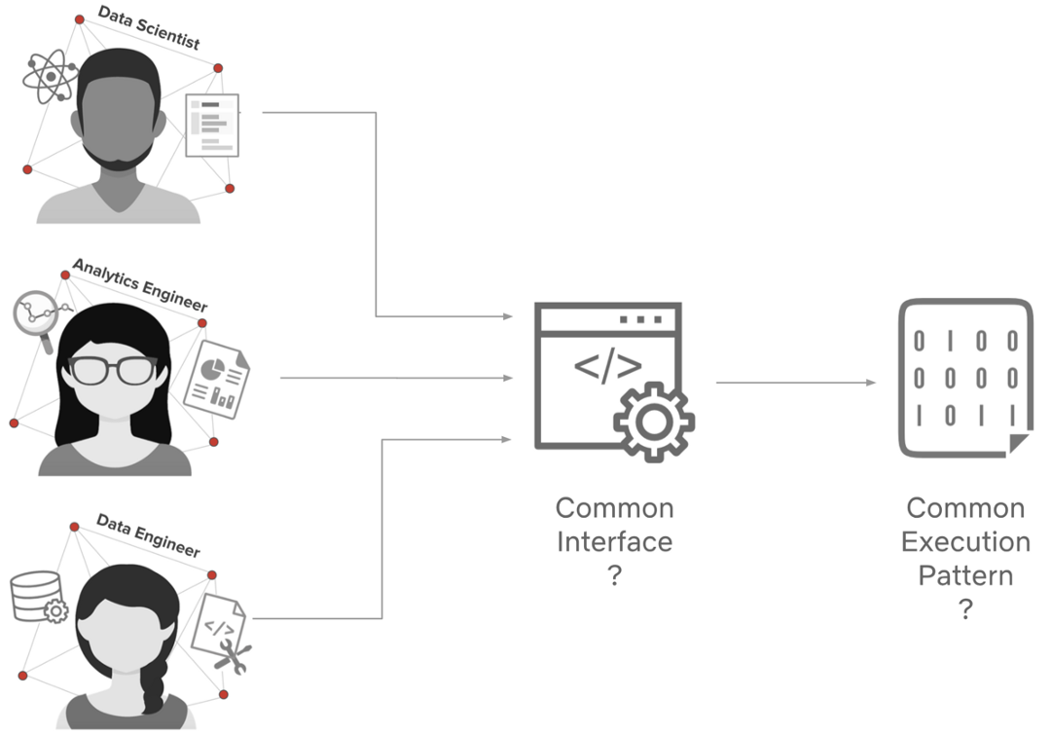
Data Roles at Netflix

Slide 28
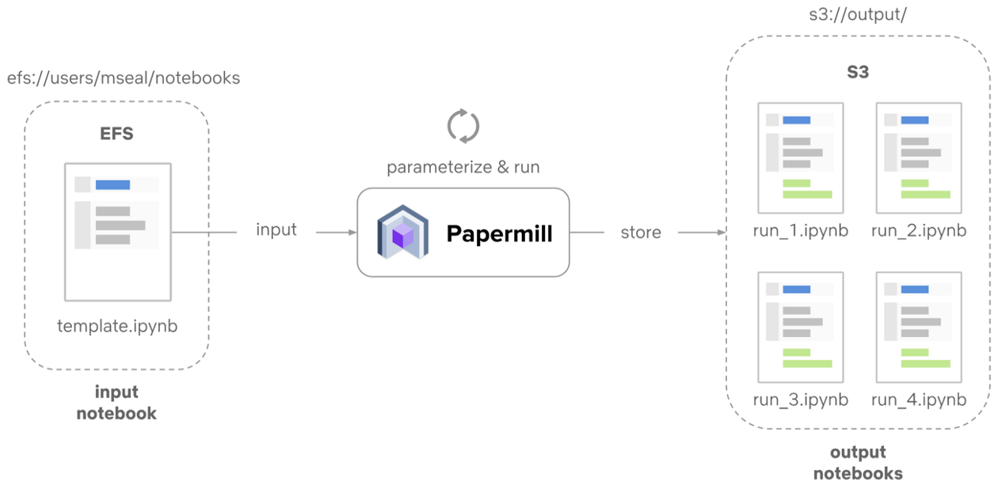
Scheduling Notebooks

Slide 29
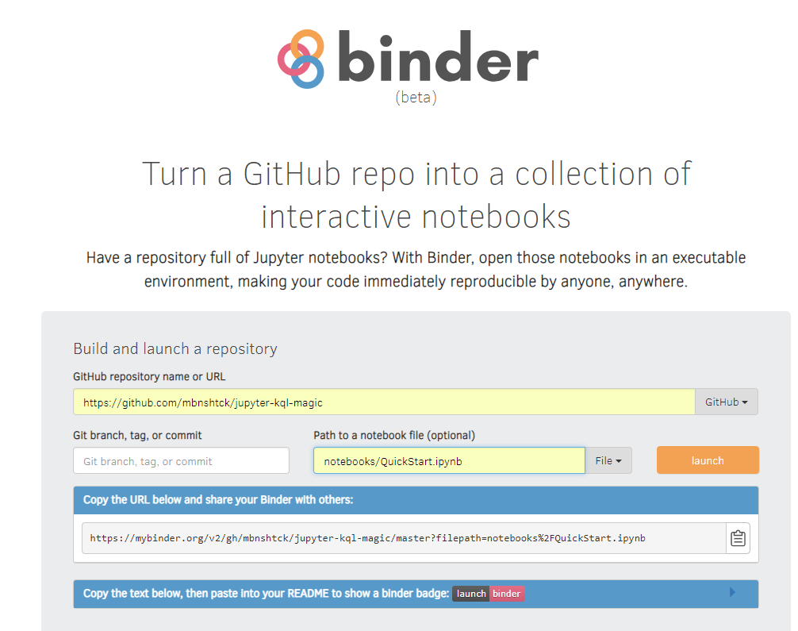
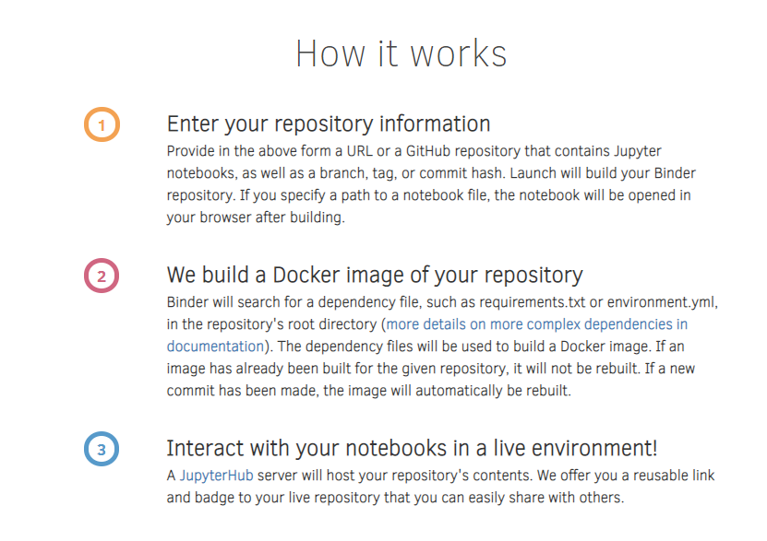

Slide 30
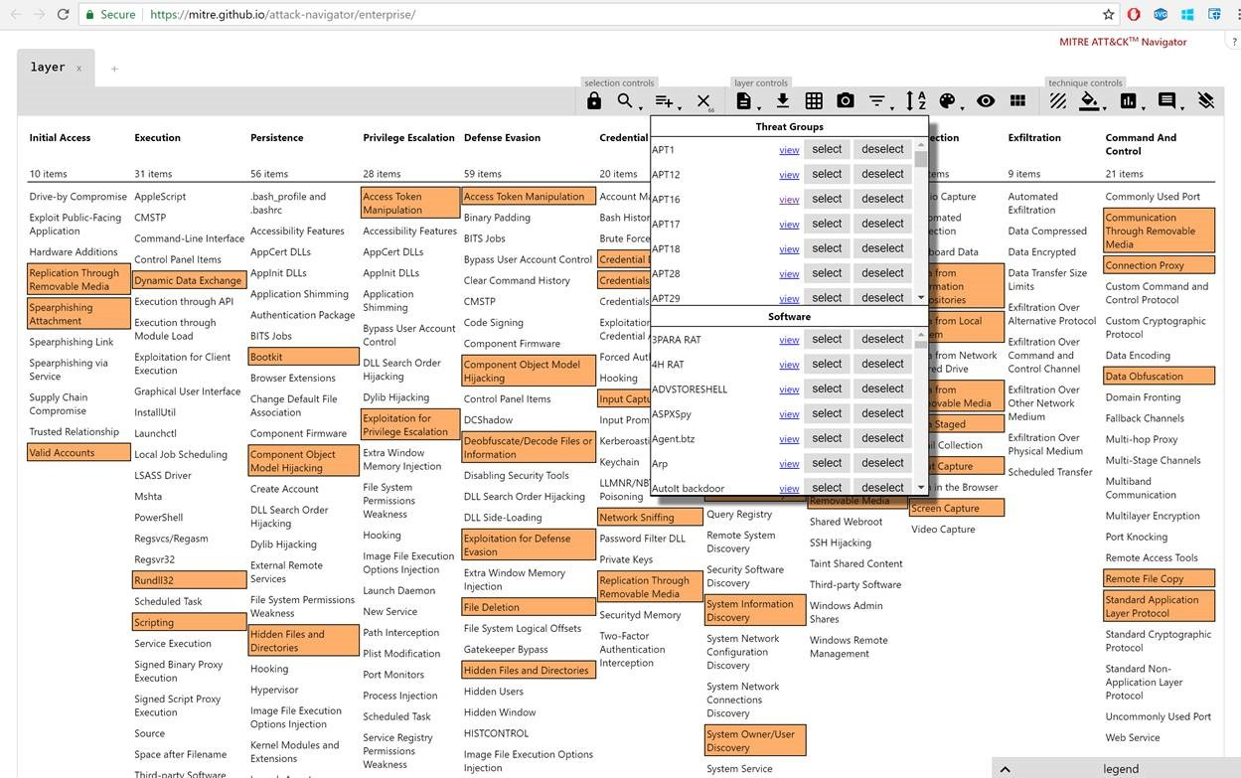
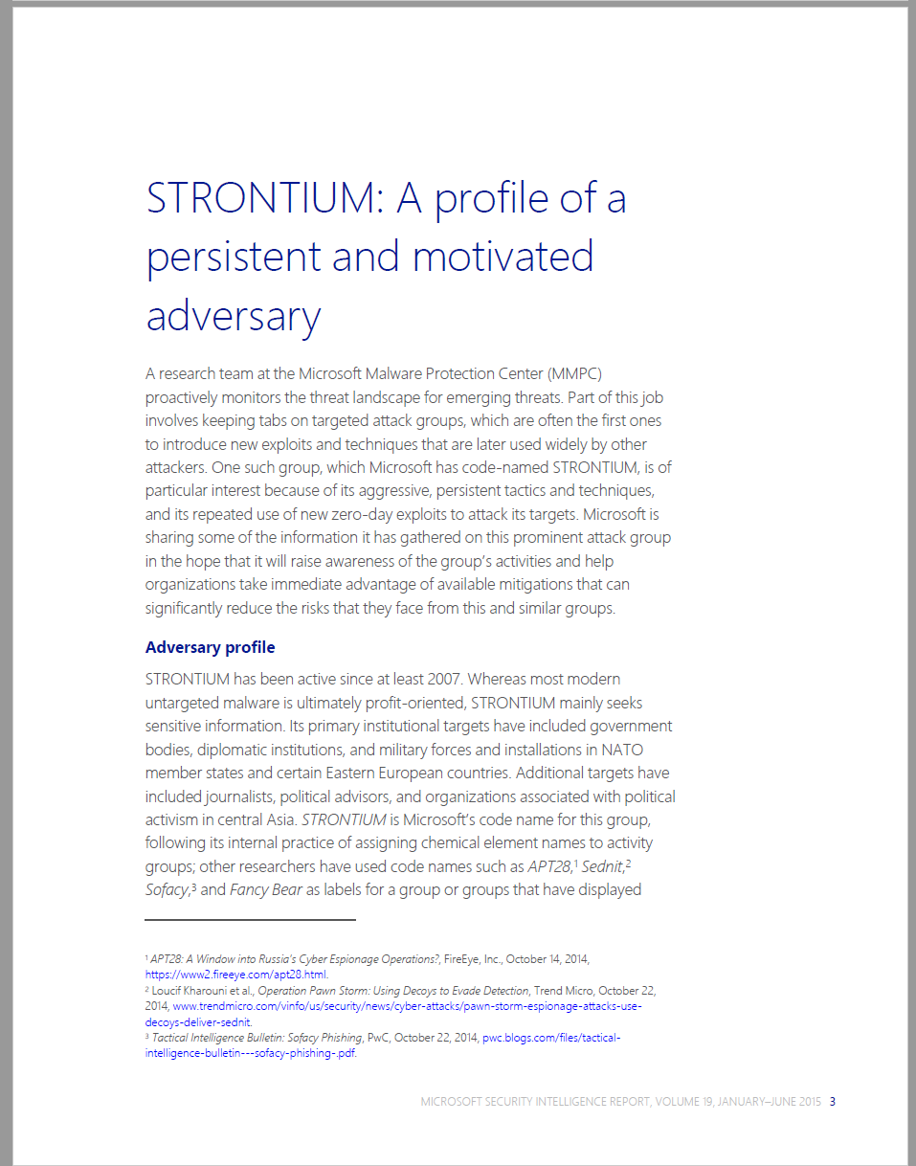




“Githubification” of Infosec
Threat Group
Technique Database
Detection Definitions
Detection Product
Analysis

Slide 31
How do we increase the rate of learning?
Promoting Community
Organized Knowledge
Executable Know-how
Repeatable Analysis
“If you want to go fast, go alone If you want to go far, go together”
African Proverb

